Slide 1
Biological Regeneration With Autologous Fibrin Membranes and Growth Factors / PRF
Stephen R. Evans DDS, FAGD, AOSB, CCN
October 13, 2013
IABDM
Houston, Texas

Slide 2
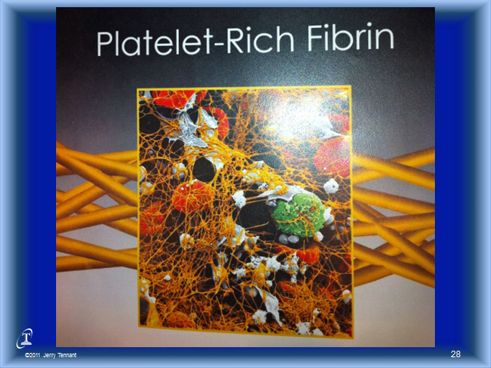

Slide 3
Acknowledgements
Dr. Eduardo Anitua
Dr. Jerry E. Bouquot
Dr. Nathan Bryan
Dr. Joseph Choukroun
Dr. Boyd E. Haley
Dr. Dietrick Klinghardt
Dr. Christopher Shade
Dr. Frank Shallenberger
Dr. Jerry Tennant

Slide 4
Truth Seekers / Speakers Motivation
Proverbs 4
7 Wisdom is the principal thing; therefore get wisdom: and with all thy getting get understanding.
Proverbs 15
33 The reverence of the Lord is the instruction for wisdom and before honor comes humility.
Proverbs 16
1 The plans of the heart belong to man, but the answer of the tongue, is from the Lord.
2 All the ways of a man are clean in his own sight; but the Lord weighs the motives.
3 Commit your works to the Lord and your plans will be established.
24 Pleasant words are as an honeycomb, sweet to the soul, and health to the bones

Slide 5
Presentation Objectives
1. To understand why the field of regeneration may be important to you and to the patients you serve.
2. To understand the critical complexities of a thorough chronological patient history and “listening” to what is important to the patient.
3. Understanding that PRF as a significant therapy for healing and regeneration of hard and soft tissue--Focus on Oral/Available for Other Options
4. To understand the relationship of systemic whole body health. The oral environment is a caldron of problems and potential beginning place of healing.
5. Coordinating and Integrating the treatment priorities of the patient, medical and dental team; including pre and post parameters/therapies to optimize clinical outcomes.
6. Provide Resources for Further Research and Development

Slide 6
Presentation Synopsis
It is very important to have a thorough and complete chronological history of patients to begin to understand and prioritize treatment options and determine if PRF is appropriate and optimal for a patient’s needs.
Integrating dental treatment and medical detoxification protocols, supportive nutritional protocols, and therapeutic modalities; as vital considerations when deciding upon all potential restorative procedures .
Gaining an understanding of each field of expertise will help optimize the treatment outcomes, however, the process begins with compassionate listening to the patient and culminating with the patients at home compliance and follow through.
UNDERSTANDING WHAT TYPE OF PRF TO USE BASED UPON CONSIDERATIONS SUCH AS; A PATIENT’S PROTOCOL NEEDS AND ABILITY TO HEAL.

Slide 7
What Type of Patients Do You See in Your Practice?
Healthy
Young
Elderly
Chronically inflamed and compromised patients who have difficulty healing for a multitude of reasons
A comprehensive chronological medical and dental history provides significant insights and decision making wisdom

Slide 8
Steve Evans—Dental Perspective
Developed a strong reputation regarding his knowledge and skills related to a healthier approach to dentistry
Concerned with soft and hard tissue wound healing, repair and regeneration to help prevent and ameliorate the multitude of oral diseases and conditions
The oral delivery system for NO offers significant benefits to enhance healing vascularization and systemic health
It has been his observation that oral health is a vital key component to obtain optimal whole body health. Disease as well as healing often begins in the mouth

Slide 9
Why is the field of regeneration important to you and the patients you serve?

Slide 10
Systems Available
1. Platelet Rich Plasma
PRP Cell Separator—Marx
PRGF—Endoret—Anitua
Vivostat
2. Leukocyte Platelet Rich Plasma L-PRP
Curasan
Regen
Plateltex
SmartPREP
PCCS
Magellan
GPSPRP

Slide 11
Systems Available
Natural Tissue Regeneration
Natural Bone Regeneration
3. Platelet Rich Fibrin
P-PRF—Fibrinet
4. Leukocyte Platelet Rich Fibrin
L-PRF—DentalXP—Choukroun
IntraSpin—Intralock—Miller
Salvin—
CGF Concentrated Growth Factors—Silfradent Medifuge— Sohn
A-PRF Advanced Platelet Rich Fibrin—Process— Choukroun

Slide 12


Leukocytes-Platelet Rich Fibrin (L-PRF®)
Process® Centrifuge System
(Dr. Joseph Choukroun System)

Slide 13
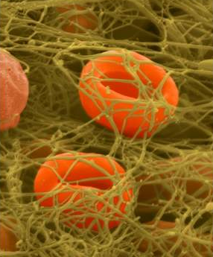
Platelets Rich Fibrin
“Choukroun's platelet-rich fibrin (PRF), a second generation platelet concentrate, is a leucocyte and platelet-rich fibrin biomaterial.”
Dohan Ehrenfest DM, de Peppo GM, Doglioli P, Sammartino G, Slow release of growth factors and thromboposdin-1 in Choukroun's platelet-rich-fibrin (PRF): a gold standard to achieve for all surgical platelet concentrates technologies, Growth Factors. 2009 Feb;27(1):63-9

Slide 14
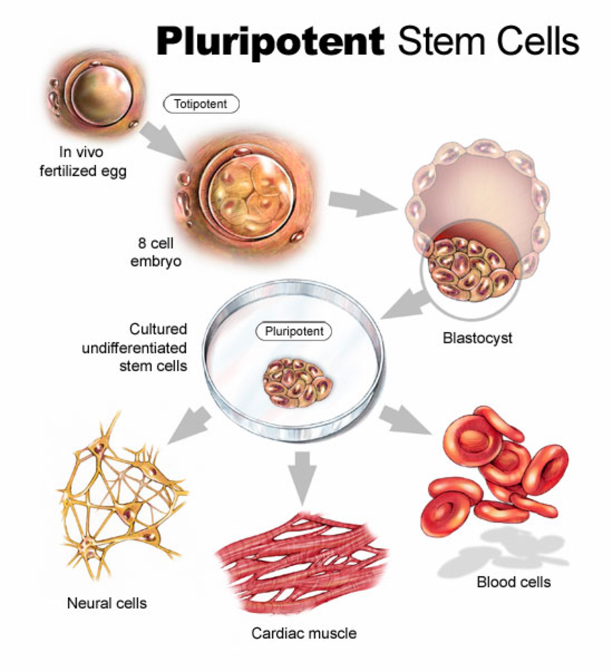
Embriogenesis: Cells Evolution

Slide 15
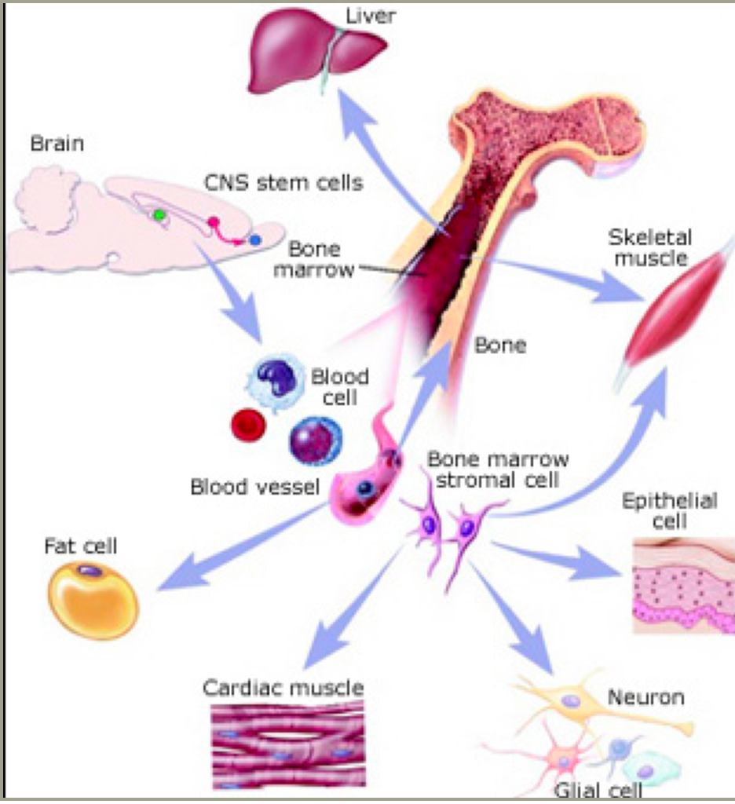
Embriogenesis: Cell
Pluripotent:
Stem Cells

Slide 16
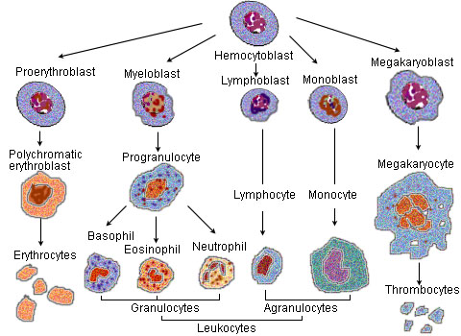
Blood Cells Maturation
Hemocytoblast
Megakaryoblast
Proerythroblast
Myeloblast
Monoblast
Lymphoblast
Erythroblast Polychromatic
Progranulocyte
Megakaryocyte
Lymphocyte
Monocyte
Basophil
Eosinophil
Neutrophil
Erythrocytes
Thrombocytes/Platelets
Granulocytes
Agranulocyte
Leukocytes

Slide 17
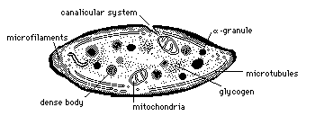
Platelets and Granules
Fragments of Megakariocytes
Life span is 8 - 12 days
Fundamental in the hemostasis
Natural source of growth factors secreted by alpha granules:
- Platelets Derived Growth Factor (PDGF)
- Tissue Growth Factor (TGF-ß)
- Fibroblasts Growth Factor (FGF)
- Insulin Like Growth Factor 1 (ILGF-1)
- Epithelial Growth Factor Platelet Derived (EGFPD)
- Endothelial Vascular Growth Factor (EVGF)

Slide 18
Growth Factors
PDGF—Platelet Derived Growth Factor
VEGF—Vascular Endothelial Growth Factor
TGF—Transforming Growth Factor
  BMP—Bone Morphogenic Proteins
IGF—Insulin-like Growth Factor
HGF—Hepatocyte Growth Factor
EGF—Epidermal Growth Factor
  SEGF—Salivary Epidermal Growth Factor
FGF—Fibroblast Growth Factor
CTGF—Connective Tissue Growth Factor
(See Glossary for Details)

Slide 19
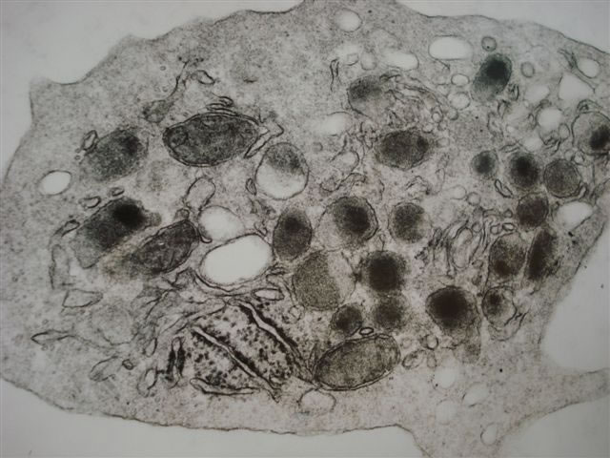
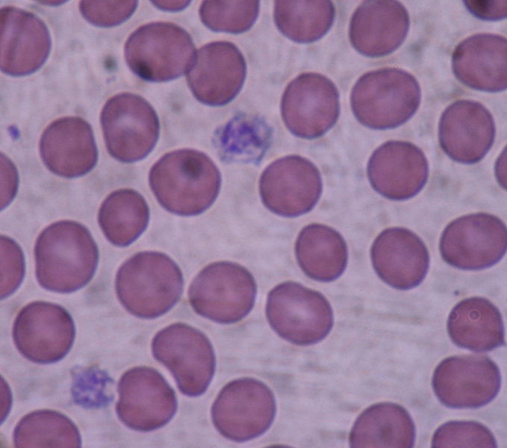
Platelets and α-Granules

Slide 20
Fundamental Elements of Bone Regeneration
Autografts, BMA
Osteogenic
Cell
Signal
Scaffold
Osteoinductive
Osteoconductive
DBM (DFDBA),BMPs,
Growth Factors
FDBA, Xenografts,
Synthetics

Slide 21
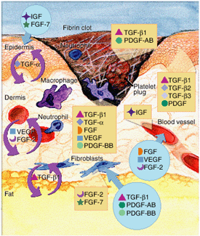
Platelets Rich Fibrin
This dense fibrin membrane releases during >7 days high quantities of three main growth factors:
Transforming Growth Factor b-1 (TGFbeta-1)
Platelet derived growth factor AB (PDGF-AB)
Vascular endothelial growth factor (VEGF)
Also, an important coagulation matricellular glycoprotein: Thrombospondin-1 (TSP-1) .
Dohan Ehrenfest DM, de Peppo GM, Doglioli P, Sammartino G, Slow release of growth factors and thromboposdin-1 in Choukroun's platelet-rich-fibrin (PRF): a gold standard to achieve for all surgical platelet concentrates technologies, Growth Factors. 2009 Feb;27(1):63-9

Slide 22
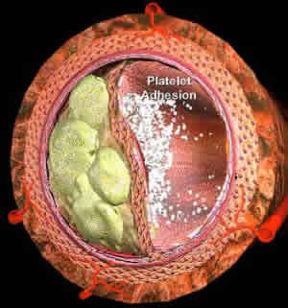
Platelets Rich Fibrin
4 fundamental events of cicatrization
angiogenesis
immune control
circulating stem cells trapping
wound-covering epithelialization
Joseph Choukroun, Antoine Diss, Alain Simonpieri, Marie-Odile Girard, Christian Schoeffler, Steve L. Dohand, Anthony J.J. Dohane, Jaafar Mouhyi, David M. Dohan, Platelet-rich fibrin (PRF): A second-generation platelet concentrate. Part IV: Clinical effects on tissue healing, Oral and Maxillofacial Surgery ,Volume 101, Issue 3, Pages e56-e60 (March 2006).

Slide 23
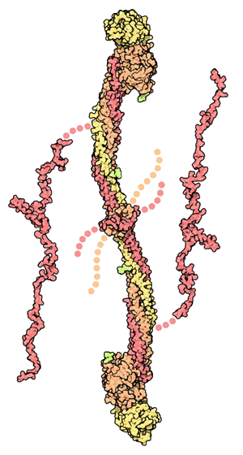
Platelets Rich Fibrin
All known clinical applications of PRF highlight an accelerated tissue cicatrization.
This accelerated tissue cicatrization is due to:
An effective neovascularization,
Accelerated wound closing
Fast cicatricial tissue remodelling
Nearly total absence of infectious events
Joseph Choukroun, Antoine Diss, Alain Simonpieri, Marie-Odile Girard, Christian Schoeffler, Steve L. Dohand, Anthony J.J. Dohane, Jaafar Mouhyi, David M. Dohan, Platelet-rich fibrin (PRF): A second-generation platelet concentrate. Part IV: Clinical effects on tissue healing, Oral and Maxillofacial Surgery ,Volume 101, Issue 3, Pages e56-e60 (March 2006).

Slide 24
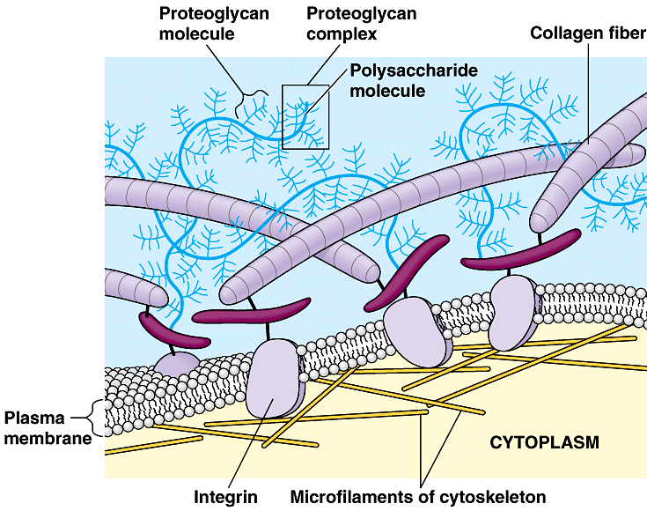
Structure of the Biological Terrain
Extracellular Fluid
Outside Cell
Lipid Cell Wall
Inside Cell
Intracellular Fluid
Notes:
Here you see part of the cell and it too is mostly biological water - however it is under the command of the extracellular fluid. This is where Marine Plasma has its most important effects in supplying nutrients and regulation.

Slide 25
Extra Cellular Matrix
Inorganic Matrix Approximately 65%
Organic Matrix Approximately 22%
  Collagen at Approximately 90%
  Non Collagen Proteins Approximately 10%
    Insoluble Proteins
      Osteonectin – Most Abundant
      Osteopontin– Binding to ECM
      Bone Sialoprotein—Attachment Protein
      Osteoblasts Secrete Oseopontin and Bone Sialoprotein
      Fibronectin—Adhesion
      Osteocalcin—Mineralization of Bone
      Growth Factors
Lipids and Macromolecules—Ca+, Po, Fe, K+ Approximately 4%
Water Approximately 9%

Slide 26
Platelet Alpha Granules
Fibrinogen→ Fibrin → Clot → Alpha Granules Release Growth Factors
Platelets are Derived From Megakaryocytes

Slide 27
Extra Cellular Matrix
Plasma—Fibrin and Fibronectin
Platelets– Vitronectin
Collagen

Slide 28
Body Response To Tissue Injury
The surgical act of a bone fracture is an injury to tissues
The injury triggers a body response cascade to generate healing:
  Inflammatory Process
  Healing Process
  Angiogenesis Process

Slide 29
Immunological Characteristics of L-PRF
L-PRF contains immunologic elements:
5 cellular mediators:
  3 pro-inflammatory cytokines
    Interleukin 1ß (IL-1ß)
    Interleukin 6 (IL-6)
    Tissue Necrosis Factor α (TNF-α)
  1 Inflammatory cytokine:
    Interleukin 4 (IL-4)
  1 Angiogenesis Promoter
    Vascular Endothelial Growth Factor (VEGF)
David M. Dohan, Joseph Choukroun, Antoine Diss, Steve L. Dohand, Anthony J.J. Dohane, Jaafar Mouhyi, Bruno Gogly, Platelet-rich fibrin (PRF): A second-generation platelet concentrate. Part III: Leucocyte activation: A new feature for platelet concentrates?, Oral and Maxillofacial Surgery ,Volume 101, Issue 3, Pages e51-e55 (March 2006).

Slide 30
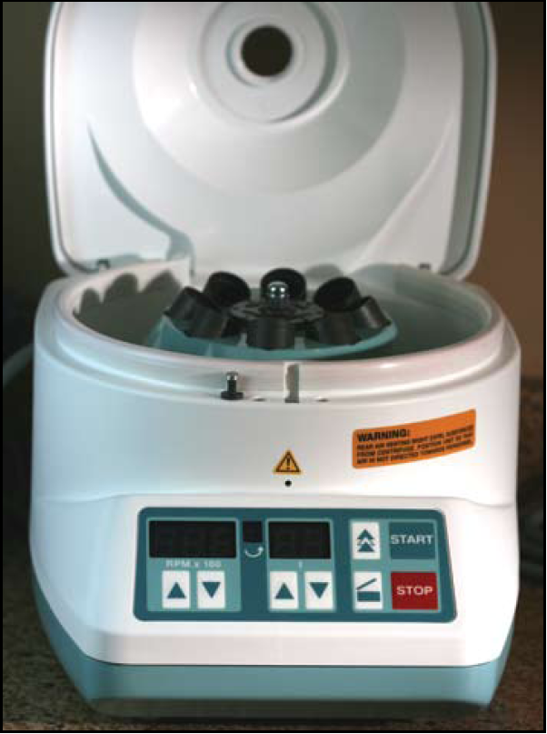
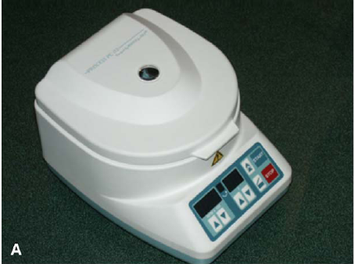
Process® Centrifuge

Slide 31
Centrifuge
G Forces—150g to 400g
Spin Speed—1,300rpm to 4,000rpm
Time—4 to 18 minutes
Temperature—As Close to Body Temperature 32 to 37 C
Angulation—Fixed 40-45 degrees or 90 degrees
Tubes—10ml Red Top Sterile Glass

Slide 32
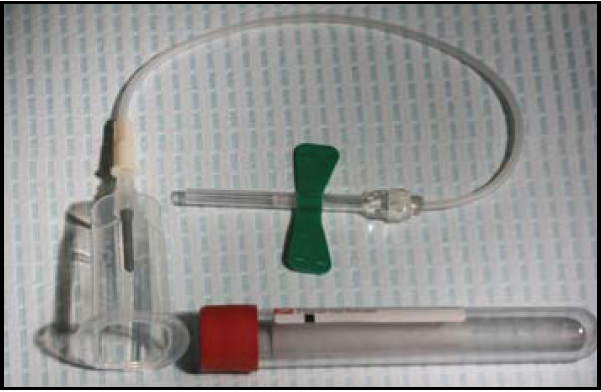
PRF Collection Kit
PRF Collection Kit including 24 gauge butterfly needle and 9 ml blood collection tube.

Slide 33
PRF Collection Kit
Suggested Sample Collection Kit:
Red Top Vacutainer® 10 ml
21 gauge Butterfly® needle/holder
Alcohol Swap
2x2 inches sterile gauze
Band-Aid®

Slide 34
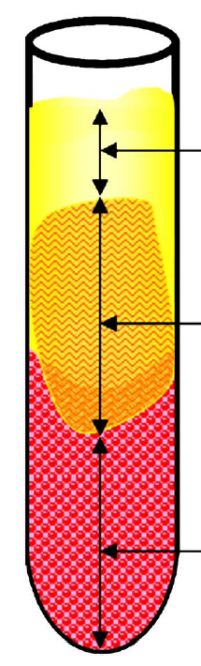
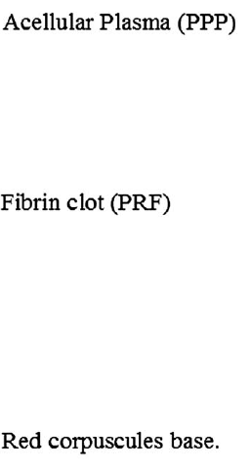
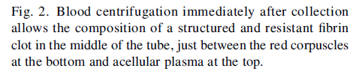
PRF Cellular Separation

Slide 35
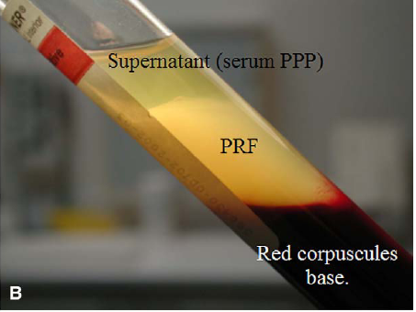
Sample Separated

Slide 36
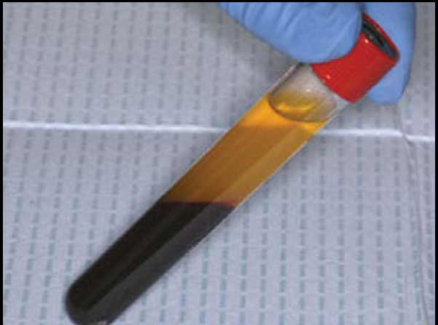
Single Centrifugation
Single spin produces 3 layers: top is platelet poor plasma, middle is PRF, and bottom layer contains red cells (RBC’s)

Slide 37
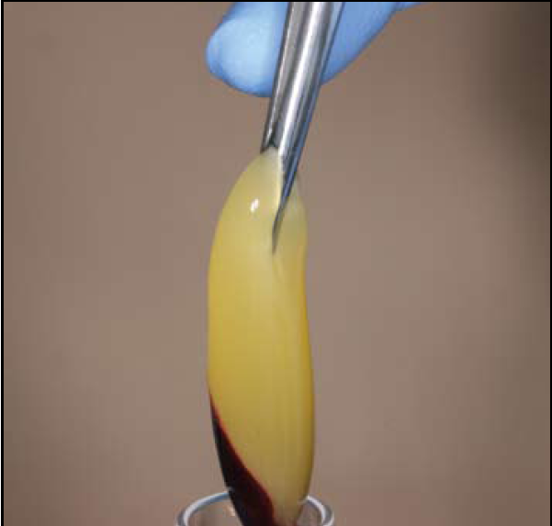
Sterile Sample Extraction
Tweezers are inserted into tube to gently grab fibrin clot with attached RBC’s

Slide 38
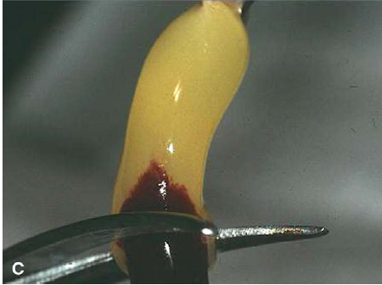
Physical Separation of Fibrin Clot
Scissors cut the PRF Clot while separating the red clot from the PRF section

Slide 39
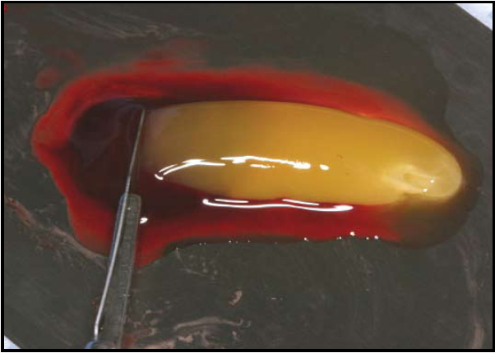
Red Cell are Separated from Fibrin
Fibrin clots are transferred to sterile metal surface and RBC’s are gently scraped away and discarded

Slide 40
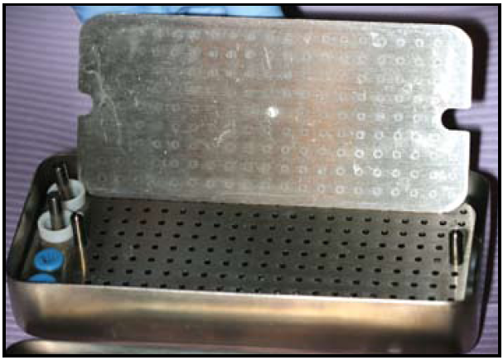
PRF Box for Sample Processing

Slide 41
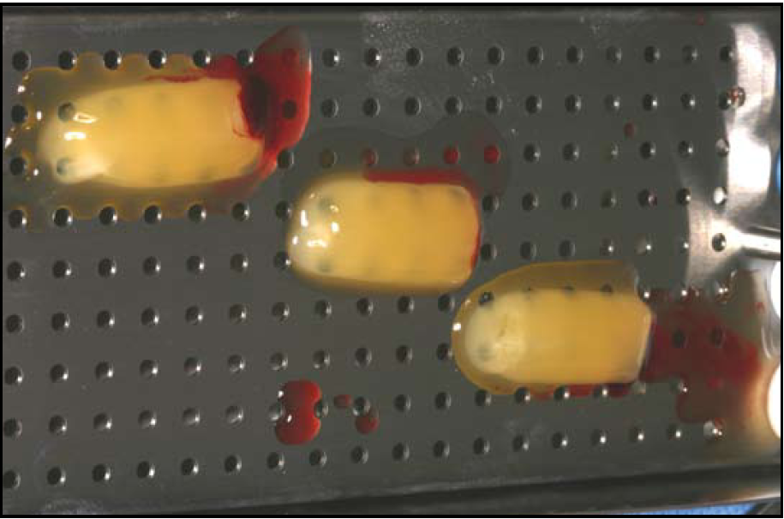
PRF Box Allows Clot to Drain
PRF clot is placed on grid of PRF Box®

Slide 42
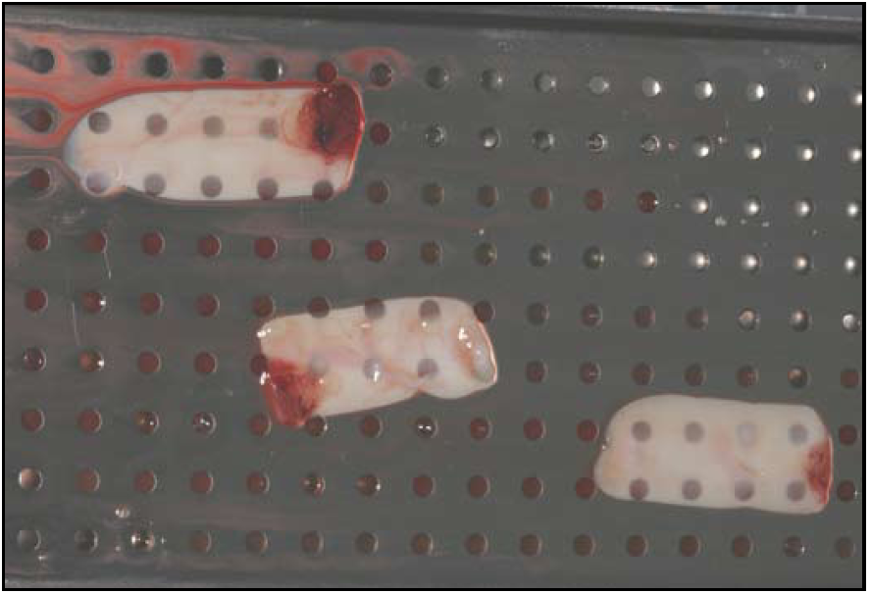
PRF Box with Drained Samples
PRF Box is used to create PRF membranes. Serum exudate collects in the bottom of the box beneath the grid.

Slide 43
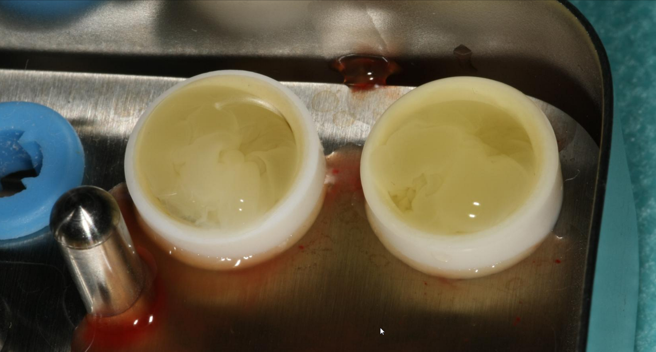
Plugs of L-PRF matrix to be made to protect extraction sockets

Slide 44
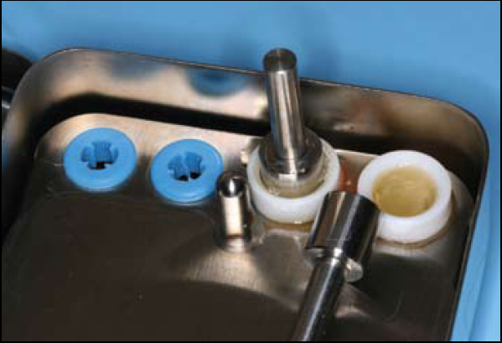
PRF Clot Being Pressed Into Membrane
Piston is inserted and PRF is pressed until top of cylinder is flush with rim of container

Slide 45
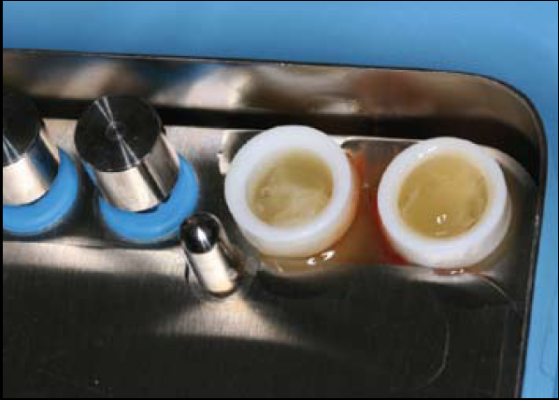
PRF Clot Conversion Into Plugs
PRF placed into cylinders in the PRF Box

Slide 46
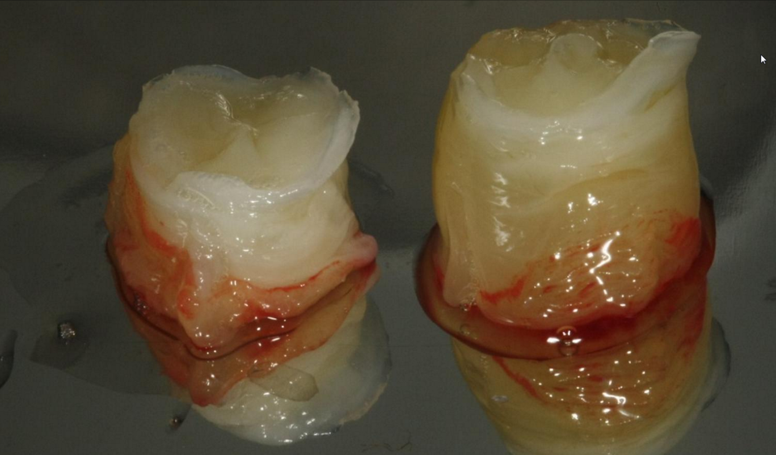
Plugs of L-PRF matrix ready to be inserted into extraction sockets

Slide 47
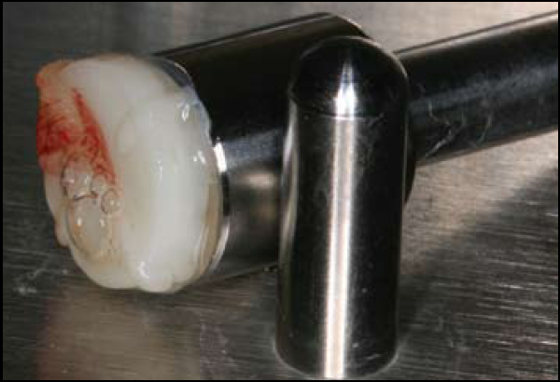
Compression Creates PRF Membrane
Compression results in the formation of a PRF plug.

Slide 48
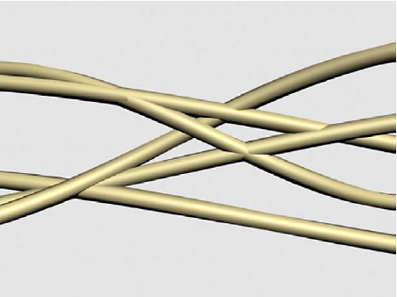
Regular Fibrin Clot
Theoretical computer modeling of condensed tetra-molecular or bilateral fibrin branch junctions. Note the rigidity of this architecture

Slide 49
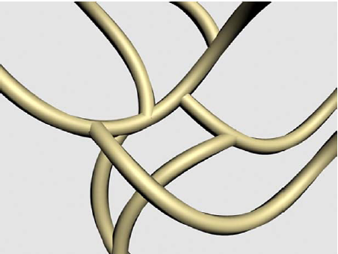
Fibrin Clot from Centrifugation
Theoretical computer modelling of tri-molecular or equilateral fibrin branch junctions. Note the flexibility of this net architecture

Slide 50
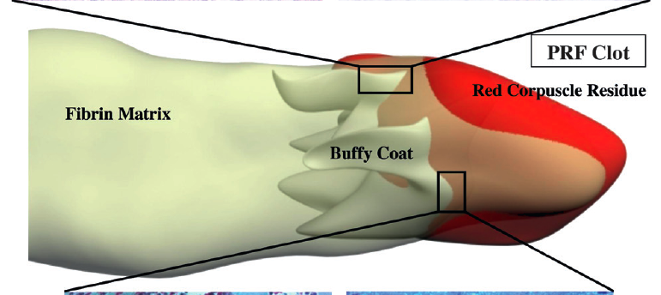
Fibrin Matrix Diagram

Slide 51
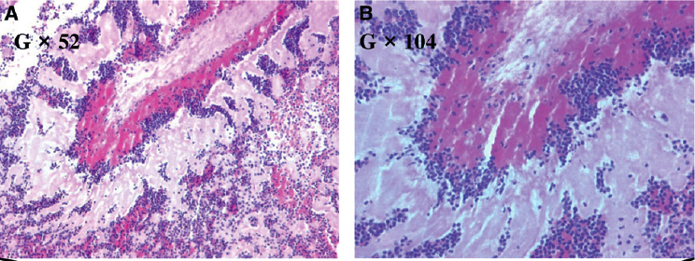
HE Stain
Light microscopy analysis off PRF clots. A and B) The hematoxilin and eosin staining were not sufficient to correctly distinguish the various cell bodies trapped in the fibrin matrix.

Slide 52
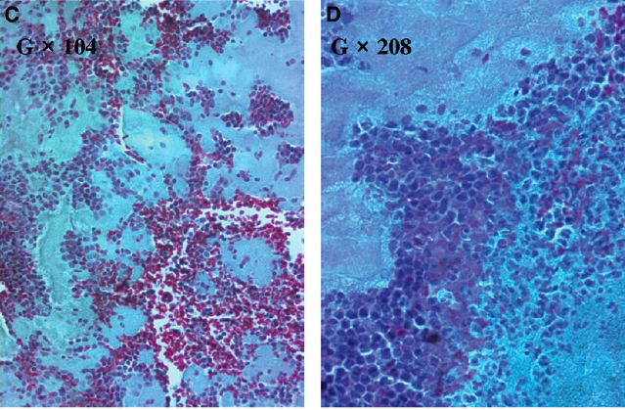
Masson’s Trichrome Stain
Light microscopy analysis off PRF clots. C and D) Using Masson’s trichrome staining it was possible to more easily separate platelet aggregares and leukocytes (dark blue) from RBCs (red). Magnifications (G) are indicated in each panel

Slide 53
Benefits
Excellent Graft Retention
Excellent Potential for New Bone Formation
Excellent Clinical Outcomes
Easy for Staff Manipulation
Economical
Autologous Biological Membranes

Slide 54
IntraSpin System
IntraSpin™ System is intended to be used for the safe and rapid
preparation of autologus Platelet Rich Fibrin (PRF) from a small
sample of blood taken at the patient’s point of care. The PRF can
be mixed with autograft and/or allograft bone prior to application
to a bony defect for improving handling characteristics. It requires
only one centrifugation without pipetting, mixing, heating or
additives.
Every component of the IntraSpin™ System has been speciﬁcally selected and engineered to act in concert as a medical device. They have been FDA cleared for the fabrication of Platelet Rich Fibrin. Use of IntraSpin™ System components ensure proper biocompatibility and clinical performance.

Slide 55
IntraSpin -- Xpression
A simple three-step processing protocol necessitates drawing
blood, spinning blood and expressing the ﬁ brin clot in the
Xpression™ Fabrication Kit. The system is comprised of
three product groups speciﬁ cally designed for completing this processing protocol.

Slide 56
Natural 100% Autologous
• No Anticoagulant
• No Bovine Thrombin
• No Heating
• No Pipetting
• No Second Spin
• No Chemical Additives
• No Expensive Consumables

Slide 57
L-PRF Leukocyte-Platelet Rich Fibrin
L-PRF™ is a 3-D autogenous combination of Platelet Rich Fibrin derived from the patient’s blood
A simpliﬁed chair side procedure results in the production of a thin, compressed layer of platelet rich ﬁbrin that is strong, pliable and suitable for suturing. This natural ﬁbrin network is rich in platelets, growth factors and cytokines that are derived from the blood platelets and leukocytes
The presence of these proteins have been reported to produce rapid healing, especially during the critical first seven days after placement. This network promotes more efﬁcient cell migration and proliferation without chemical or bovine thrombin additives

Slide 58
L-PRF Leukocyte-Platelet Rich Fibrin
Simple and economic4
• Natural - 100% autologous4
• Thin Fibrin Matrix & Plugs4
• Leukocytes, Platelets and Fibrin1
• Slow Release at ≥ 7 days1
• Matrix for Bone Graft Material5

Slide 59
L-PRF Leukocyte-Platelet Rich Fibrin
Clinically, Leukocyte-Platelet Rich Fibrin displays excellent
working properties. This biomaterial is resilient, strong and
pliable, making it easy to manipulate. It can be cut to size,
and is supple enough to adapt to many anatomical areas. It is
adhesive in nature and very receptive to suturing. In addition,
there is ample working time since L-PRF™ is stable at room
temperature for several hours4
.

Slide 60
L-PRF Leukocyte-Platelet Rich Fibrin
L-PRF™ matrix acts as a carrier for
particulate bone material4
. When
incorporated, the graft material is
suspended in the ﬁbrin matrix and
handling characteristics are dramatically improved.

Slide 61
Applications in Dental/oral and Maxillofacial Surgical Sites
Including but not limited to:
Bone defects5
Extraction sockets1,4,5,6
Sinus and dental ridge augmentation4,5
Palatal defects7
Maxillary bone atrophy1,5

Slide 62
Eduardo Anitua MD, DDS, PhD
A Biological Approach to Implantology
Head of the Eduardo Anitua Institute, Scientific Director of BTI and President of the
Eduardo Anitua Foundation for biomedical research.
Degree in Medicine and Surgery from the University of Salamanca.
Doctor of Medicine from the University of Valencia.
Specialized in Stomatology at the University of the Basque Country (UPV/EHU).
Diploma in Prostheses and Occlusion from the Pankey Institute (Florida, USA).
· Author of more than 200 articles in national and international journals.
· Author of 6 books and co-author of 5 books and chapters translated into
several languages.
· Editor and Director of the journal Dental Dialogue.
· Has published 37 international patents in the fields of regenerative therapy
and oral implantology.
· Head of the “Continual training in implantology and oral rehabilitation”
Program, which is taught in Spain and various other countries throughout the
world, for more than 20 years.
· Has given more than 500 courses and conferences on Tissue Regeneration,
Implantology, Prostheses, and Dental Esthetics at both national and
international conferences all over the world.

Slide 63
What is PRGF?
PRGF®-Endoret® s the market's most advanced system for obtaining platelet-rich autologous plasma.
It is based on the formulation and use of the patient's own proteins with biological activity, growth factors and fibrin biomaterial for the stimulation and acceleration of tissue healing and regeneration.
It is 100% biocompatible technology, with excellent versatility, safety and effectiveness. The potential of this technology derives from the global effect of the platelets' growth factors which include, among others, VEGF, FGF, PDGF, TGF-B, EGF, IGF-I. These factors influence a series of biological processes that favor cellular migration, growth and morphogenesis. In addition they accelerate the “on site” formation process of a biodegradable fibrin matrix that acts as a temporary “scaffold” that facilitates tissue regeneration. The versatility, safety and effectiveness of this system opens the door to personalized medicine, which is already being applied in many medical and scientific fields, including oral and maxillofacial surgery, oral implantology, orthopedics, ulcer treatments, sports medicine, facial resurfacing, ophthalmology and tissue engineering, among others
- See more at: http://bti-biotechnologyinstitute.com/gb/dental/regeneration/#sthash.VO5HymgG.dpuf

Slide 64
Advantages of PRGF
100% biocompatible, versatile and safe.
Control over its activation and use.
A simple protocol: just one centrifugation.
A fast protocol: just 8 minutes of centrifugation and 20 minutes of preparation.
Its clinical efficiency in the stimulation of tissue healing and regeneration has been described in a large number of international articles.
It does not contain leucocytes, avoiding their pro-inflammatory activity.
Powerful bacteriostatic properties.
Excellent therapeutic potential in different clinical applications.
It is backed by a large number of international scientific studies and publications with a high impact.
- See more at: http://bti-biotechnologyinstitute.com/gb/dental/regeneration/#sthash.VO5HymgG.dpuf

Slide 65
Application of PRGF-Endoret in Odontology
PRGF®-Endoret® Is the most advanced system there is for obtaining platelet-rich autologous plasma, and can be applied directly on the dental implant surface improving osseointegration, and with it, the primary stability of the implant surgery.
Periodontal disease leads to a loss of supporting structures that include the cementum, the periodontal ligament and the alveolar bone. Conventional treatments such as scaling and root planing are effective to improve the health of the periodontal tissues and to slow down the progression of the disease, but they do not manage to effectively regenerate the periodontal support lost. An inconvenience found with current periodontal regenerative treatment procedures is their limited predictability.
PRGF®-Endoret®formulationsThe complete restoration of the insertion system of each defect treated is not yet a reality. To achieve the regeneration of the periodontium a series of biological events must unfold that include lithogenesis, chemotaxis, cellular adhesion and differentiation, which would lead to a functional periodontal unit.
PRGF®-Endoret® is used in oral surgery to promote bone and adjacent soft tissue regeneration in post-extraction defects. The method consists of filling and sealing the post-extraction defects with the standard biological matrix and with autologous fibrin.
The wetting of the implant surfaces with non-activated PRGF®-Endoret® creates a much more favorable biological environment for Osseo integration, as a protein interface is achieved that favors cell migration over the new fibrin bridges created between the osseous wall and the implant surface.
- See more at: http://bti-biotechnologyinstitute.com/gb/dental/regeneration/#sthash.VO5HymgG.dpuf

Slide 66
Regeneration Future
Growing Rapidly
Inspires Imagination For Possibilities

Slide 67
Available in Europe
The Vivostat® system
The uniqueness of the Vivostat® system is a novel patented biotechnological process that enables reliable and reproducible preparation of autologous Fibrin Sealant or Platelet Rich Fibrin (PRF®) without using cryoprecipitation and without the need for a separate thrombin component. The fully automated Vivostat® system consists of three components:
The Processor Unit
The Processor Unit is used to process the patient’s blood and prepare the Vivostat® Fibrin Sealant or Vivostat PRF® solution.
The Applicator Unit
The Applicator Unit controls the delivery of the Vivostat® solution to the site of treatment.
The Disposable Set
The single-use set contains all components needed for preparation and application of Vivostat® Fibrin Sealant or Vivostat PRF®. It is available with a range of application devices each optimised for different types of applications.

Slide 68
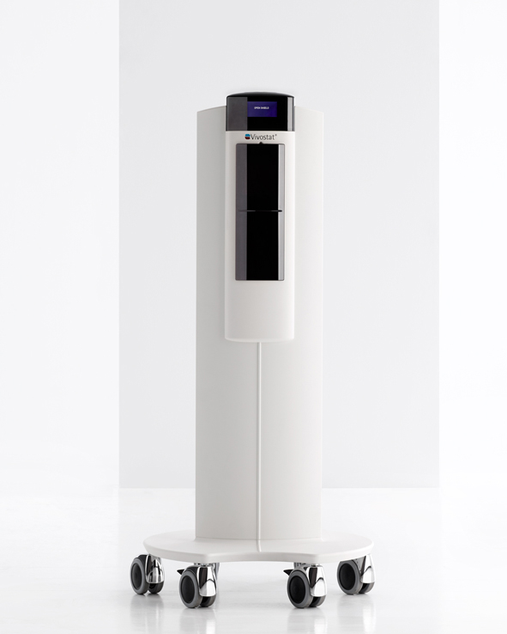
The Vivostat® Co-Delivery System

Slide 69
The Vivostat® Co-Delivery System
Vivostat has developed the revolutionary Co-Delivery system that makes it possible to co-deliver a desired substance¹ (drugs, stem cells etc.) with Vivostat® Fibrin Sealant or Vivostat PRF® (Platelet Rich Fibrin)
Vast opportunities
The opportunities with the Vivostat® Co-delivery system are vast and the system allows the surgeon to apply a selected substance easily and effectively. Furthermore, it may be possible to reduce the total cost of a procedure by using the Vivostat® Co-Delivery system²

Slide 70
Vivostat System
Options for Co-Delivery Include:
Drugs Antibiotics Chemotherapeutics Pain medications | Stem cells Bone marrow derived Adipose tissue derived

Slide 71
Vivostat® Autologous Fibrin Sealant
For many years specialists have prepared autologous fibrin sealant based on thrombin and fibrinogen. The process is complicated, labour intensive and time consuming. With the Vivostat® system this process becomes fast and uncomplicated.
The uniqueness of the Vivostat® system is a novel patented biotechnological process that enables reliable and reproducible preparation of autologous fibrin sealant and related products without using cryoprecipitation and without the need for a separate thrombin component. Furthermore, Vivostat®Fibrin Sealant does not contain any bovine components and is completely aprotinin-free.
It is designed to provide the best possible solution for many different settings independent of whether it is used in the surgical area or centrally in e.g. the transfusion centre or the blood bank. The straightforward and intuitive operation means that there is no need for specially trained personnel.

Slide 72
Vivostat Co-Delivery Supporting Evidence
Tumors
Intrapleural topical application of cisplatin with the surgical carrier Vivostat increases the local drug concentration in an immune-competent rat model with malignant pleuromesothelioma Lardinois D. et al. J Thorac Cardiovasc Surg 2006;131:697-703
Local recurrence model of malignant pleural mesothelioma for investigation of intrapleural treatment Opitz I. et al. European Journal of Cardio-thoracic Surgery 31 (2007) 772—778
Optimized intrapleural cisplatin chemotherapy with a fibrin carrier after extrapleural pneumonectomy: A preclinical study Opitz I. et al
The Journal of Thoracic and Cardiovascular Surgery 2011; Volume 141, Number 1: 65-71
Stem Cells
Autologous Valve Replacement—CD133þ Stem Cell-Plus-Fibrin Composite-Based Sprayed Cell Seeding for Intraoperative Heart Valve Tissue Engineering Kaminski A. et al. Tissue Engineering: Part C Volume 00, Number 00, 2010 DOI: 10.1089/ten.tec.2010.0051
Bone marrow
Use of autologous bone marrow cells concentrate enriched with platelet-rich fibrin on corticocancellous bone allograft for posterolateral multilevel cervical fusion Vadalà G. et al. Journal of Tissue Engineering and Regenerative Medicine 2008; 2: 515–520.
Wound tratment
The co-application of sprayed cultured autologous keratinocytes and autologous fibrin sealant in a porcine wound model Grant I. et al. British Journal of Plastic Surgery 2002, 55, 219–227

Slide 73
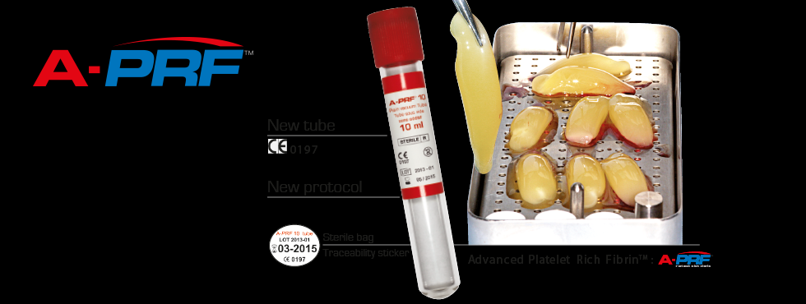
Advanced-PRF
New 10ml Tube
Decreased G Forces (Spin Speed)
Decreased Time
Temperature 35 to 37 C
Increase Fibrin Membrain BMP 2 and 7

Slide 74
Platelet-Rich Fibrin Promotes Periodontal Regeneration and
Enhances Alveolar Bone Augmentation
January 2013
Qi Li,1,2 Shuang Pan,3 Smit J. Dangaria,1 Gokul Gopinathan,1 Antonia Kolokythas,4
Shunli Chu,2 Yajun Geng,5 Yanmin Zhou,2 and Xianghong Luan1
1 UIC Brodie Laboratory for Craniofacial Genetics, 801 South Paulina, Chicago, IL 60612, USA
2Department of Implantology, Stomatological Hospital, Jilin University, Changchun, Jilin 130021, China
3Department of Endodontics, School of Dentistry, Harbin Medical University, Harbin, China
4Department of Oral and Maxillofacial Surgery, UIC College of Dentistry, Chicago, IL, USA
5The First Hospital of Jilin University, Jilin, China

Slide 75
PRF Abstract
In the present study we have determined the suitability of platelet-rich fibrin (PRF) as a complex scaffold for periodontal tissue regeneration. Replacing PRF with its major component fibrin increased mineralization in alveolar bone progenitors when compared to periodontal progenitors, suggesting that fibrin played a substantial role in PRF-induced osteogenic lineage differentiation.
There was a 3.6-fold increase in the early osteoblast transcription factor RUNX2 and a 3.1-fold reduction of the mineralization inhibitor MGP as a result of PRF application in alveolar bone progenitors, a trend not observed in periodontal progenitors. Subcutaneous implantation studies revealed that PRF readily integrated with surrounding tissues and was partially replaced with collagen fibers 2 weeks after implantation.
Finally, clinical pilot studies in human patients documented an approximately 5mm elevation of alveolar bone height in tandem with oral mucosal wound healing. Together, these studies suggest that PRF enhances osteogenic lineage differentiation of alveolar bone progenitors more than of periodontal progenitors by augmenting osteoblast differentiation,
They also document that PRF functions as a complex regenerative scaffold promoting both tissue-specific alveolar bone augmentation and surrounding periodontal soft tissue regeneration via progenitor-specific mechanisms.

Slide 76
Introduction
Regenerative oral medicine entails the replacement of tissues lost to disease or injury with physiologically equivalent rengineered tissues. Often, tissues in the oral cavity are of complex nature with bordering mineralized and soft tissue components, both of which harbor unique progenitor populations residing within specialized extracellular matrix frameworks [1, 2].
Mimicking such complex environments by using chemically homogenous scaffolds and uniform stem cell populations is often challenging. Instead, recent approaches favor complex natural scaffolds that allow for repopulation with the patient’s own cells, thereby producing an autologous tissue-engineered organ [3].

Slide 77
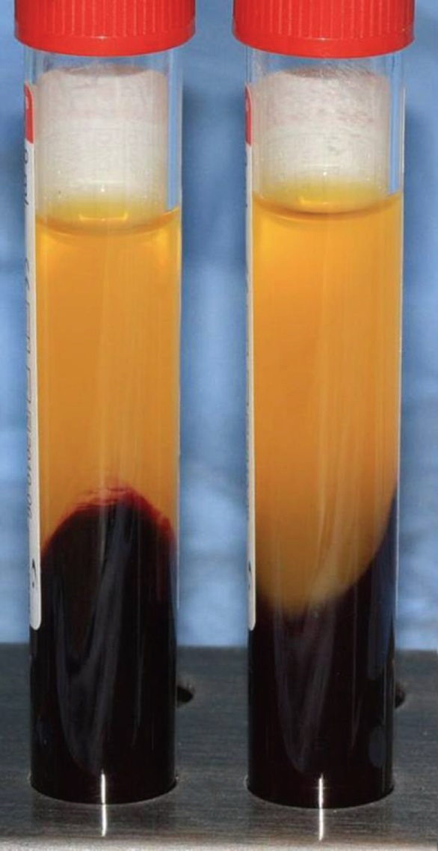
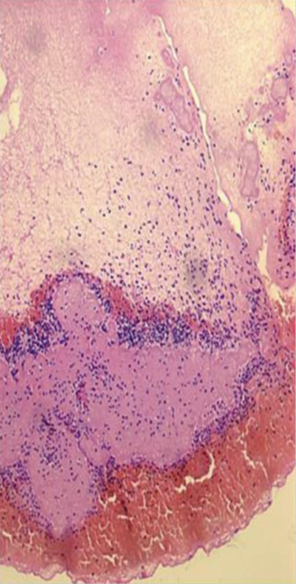
Figure 1: Preparation and Structure of PRF a b c d

Slide 78
Figure 1: Preparation and Structure of
Platelet-Rich Fibrin (PRF)
a) Shows three fractions of whole blood generated by low-speed
centrifugation: platelet-poor plasma (PPP), platelet-rich fibrin (PRF), and red blood cells (RBC). At this stage, PRF and RBC have formed
a gel, while the PPP fraction remains liquid.
(b) Mechanical separation of the RBC fraction from the PRF fraction after decanting the PPP
fraction.
(c) Generation of solid PRF after liquid removal
(d) 5 𝜇m paraffin section through solidified PRF generated in (c). The section contains three portions: (i) the cell-free fibrin clot, (ii) the buffy coat portion containing white blood cells (WBC) and platelets (PLT), and (iii) the red blood cell (RBC) portion. Note that the majority of the white blood cells and platelets are trapped in the buffy coat.

Slide 79
(RBC) (Figure 1(a)).
The PRF fraction was further isolated by decanting the soluble PPP fraction and by mechanically removing the RBC fraction (Figure 1(b)). Liquid removal from the PRF fraction through mechanical pressure between gauze layers resulted in a fairly solid, gel-like material (Figure 1(c)).
H&E-stained paraffin sections through the PRF clot revealed three portions: (i) the cell-free fibrin clot, (ii) the buffy coat portion containing white blood cells (WBC) and platelets (PLT), and (iii) the red blood cell (RBC) portion (Figure 1(d)).
or the experiments described herein, the entire PRF clot was used, including fibrin, white blood cells, and platelets. The red blood cells immediately attached to the PRF clot were not further separated.

Slide 80
PRF Promotes Periodontal Regeneration and Enhances Alveolar Bone Augmentation Research*
From clinical perspective, the reported effects of PRF on bone regeneration [31, 32] are of great interest for orthopedic applications because of the limitations of current strategies to enhance bone regeneration [33].
Moreover, alveolar ridge augmentation is of great benefit to implant dentistry because of the lack of supporting bone for implant placement [34].
Our in vitro studies indicated that PRF almost equaled osteogenic medium in its effect on mineralization behavior of cultured periodontal progenitors, surpassing DMEM and PPP by a significant margin.
*BioMed Research International Volume 2013, Article ID 638043 (13 pages)

Slide 81
PRF Conclusion
While the effect of PRF on osteoblast alkaline phosphatase levels [8] and on the formation of mineral nodules [35] has already been reported, we have demonstrated here that PRF significantly enhances the expression of the osteoblast differentiation transcription factor RUNX2 and reduces expression of the mineralization inhibitor MGP, preferentially in alveolar bone osteoblast progenitors, and less so in dental follicle cells and periodontal ligament progenitors.
We propose that this tissue-specific enhancement of osteoblast mineralization might be due to the enhanced alkaline phosphatase activity induced by the fibrin component of PRF (shown in the present study) and to the greater susceptibility of osteoblast cells to differentiate along osteogenic lineage pathways.

Slide 82
PRF Conclusion
Both our in vitro and our clinical studies indicate that the benefit of PRF for bone regenerative procedures lies in its combined competency as a cell proliferation, migration, and wound-healing agent together with its tissue-specific ability to promote osteoblast differentiation and new bone formation.
Our clinical pilot experiments revealed peri-implant bone gain of approximately 5mm in conjunction with soft tissue healing around the implant site—a highly desirable outcome, in which we attribute the combined biological effects of PRF on gingival fibroblast and periodontal ligament cell migration, as well as alveolar bone osteoblast proliferation and mineralization.

Slide 83
PRF Conclusion
PRF is a biodegradable scaffold as our studies have demonstrated that PRF subcutaneous implants were readily replaced with dense collagen even after 2 weeks of implant placement in nude mice, suggesting excellent biodegradability.
The combinatorial effects of PRF on soft tissue healing and bone regeneration may limit its use in regenerative medicine applications in which calcification is not a desired outcome; however, our studies indicate that PRF contains a number of attributes ideally suited for its use as a scaffold for alveolar ridge augmentation and bone healing.

Slide 84
PRF References
[1] S. J.Dangaria, Y. Ito, C.Walker,R.Druzinsky,X. Luan, andT.G. H. Diekwisch, “Extracellular matrix-mediated differentiation of periodontal progenitor cells,” Differentiation, vol. 78,no. 2-3, pp. 79–90, 2009.
[2] S. J. Dangaria, Y. Ito, X. Luan, and T. G. Diekwisch, “Successful periodontal ligament regeneration by periodontal progenitor preseeding on natural tooth root surfaces,” Stem Cells, vol. 20, no. 10, pp. 1659–1668, 2011.
[3] A. Hollander, P. Macchiarini, B. Gordijn, and M. Birchall, “The first stemcell-based tissue-engineered organ replacement: implications for regenerative medicine and society,” Regenerative Medicine, vol. 4, no. 2, pp. 147–148, 2009.
[4] J. Choukroun, F. Adda, C. Schoeffer, and A. Vervelle, “PRF: an opportunity in perio- implantology,” Implantodontie, vol. 42,pp. 55–62, 2000.
[5] D. M. Dohan, J. Choukroun, A. Diss et al., “Platelet-rich fibrin (PRF): a second-generation platelet concentrate. Part II: platelet-related biologic features,” Oral Surgery, Oral Medicine, Oral Pathology, Oral Radiology and Endodontology, vol. 101, no. 3, pp. E45–E50, 2006.
[6] W. Bensa¨ıd, J. T. Triffitt, C. Blanchat, K.Oudina, L. Sedel, andH. Petite, “A biodegradable fibrin scaffold for mesenchymal stem cell transplantation,” Biomaterials, vol. 24,no. 14,pp. 2497–2502,
2003.
[7] Y. H. Kang, S. H. Jeon, J. Y. Park et al., “Platelet-rich fibrin is a bioscaffold and reservoir of growth factors for tissue regeneration,” Tissue Engineering A, vol. 17,no. 3-4, pp. 349–359, 2011.

Slide 85
References
[8] L. He,Y. Lin,X.Hu, Y. Zhang, andH.Wu, “A comparative study of platelet-rich fibrin (PRF) and platelet-rich plasma (PRP) on the effect of proliferation and differentiation of rat osteoblasts in vitro,” Oral Surgery, Oral Medicine, Oral Pathology, Oral Radiology and Endodontology, vol. 108, no. 5, pp. 707–713, 2009.
[9] D. M. D. Ehrenfest, A. Diss, G. Odin, P. Doglioli, M. P. Hippolyte, and J. B. Charrier, “In vitro effects of Choukroun’s PRF (platelet-rich fibrin) on human gingival fibroblasts, dermal
prekeratinocytes, preadipocytes, and maxillofacial osteoblasts in primary cultures,” Oral Surgery, Oral Medicine, Oral Pathology, Oral Radiology and Endodontology, vol. 108, no. 3, pp. 341–352, 2009.
[10] J. Choukroun, A. Diss, A. Simonpieri et al., “Platelet-rich fibrin (PRF): a second-generation platelet concentrate. Part IV: clinical effects on tissue healing,” Oral Surgery, Oral Medicine,
Oral Pathology, Oral Radiology and Endodontology, vol. 101, no. 3, pp. E56–E60, 2006.
[11] M. T. Peck, J. Marnewick, and L. Stephen, “Alveolar ridge preservation using leukocyte and platelet-rich fibrin: a report of a case,” Case Reports in Dentistry, vol. 2011, Article ID 345048, 5 pages, 2011.
[12] A. Sharma and A. R. Pradeep, “Treatment of 3-wall intrabony defects in patients with chronic periodontitis with autologous platelet-rich fibrin: a randomized controlled clinical trial,” Journal of Periodontology, vol. 82, no. 12, pp. 1705–1712, 2011.
[13] M. Thorat, A. R. Pradeep, and B. Pallavi, “Clinical effect of autologous platelet-rich fibrin in the treatment of intrabony defects: a controlled clinical trial,” Journal of Clinical
Periodontology, vol. 38, no. 10, pp. 925–932, 2011.

Slide 86
References
[14] F. Inchingolo,M. Tatullo, M.Marrelli et al., “Trial with plateletrich fibrin and Bio-Oss used as grafting materials in thetreatment of the severe maxillar bone atrophy: clinical and
radiological evaluations,” European Review for Medical and Pharmacological Sciences, vol. 14, no. 12, pp. 1075–1084, 2010.
[15] Y. Zhang, S. Tangl, C. D. Huber, Y. Lin, L. Qiu, and X. Rausch-Fan, “Effects of Choukroun’s platelet-rich fibrin on bone regeneration in combination with deproteinized bovine bone mineral in maxillary sinus augmentation: a histological and histomorphometric study,” Journal of Cranio-Maxillofacial Surgery, vol. 40, no. 4, pp. 321–328, 2011.
[16] C. H. Tsai, S. Y. Shen, J. H. Zhao, and Y. C. Chang, “Plateletrich fibrin modulates cell proliferation of human periodontally related cells in vitro,” Journal of Dental Sciences, vol. 4, no. 3, pp. 130–135, 2009.
[17] Y. C. Chang and J. H. Zhao, “Effects of platelet-rich fibrin on human periodontal ligament fibroblasts and application for periodontal infra-bony defects,” Australian Dental Journal, vol.
56, no. 4, pp. 365–371, 2011.
[18] D. M. Dohan, J. Choukroun, A. Diss et al., “Platelet-rich fibrin (PRF): a second-generation platelet concentrate. Part I: technological concepts and evolution,” Oral Surgery, Oral
Medicine, Oral Pathology, Oral Radiology and Endodontology, vol. 101, no. 3, pp. E37–E44, 2006.
[19] K. J. Livak and T. D. Schmittgen, “Analysis of relative gene expression data using real-time quantitative PCR and the 2−ΔΔ𝐶T method,” Methods, vol. 25, no. 4, pp. 402–408, 2001.
[20] E. Sachlos and J. T. Czernuszka, “Making tissue engineering scaffolds work. Review: the application of solid freeform fabrication technology to the production of tissue engineering
scaffolds,” European Cells &Materials Journal, vol. 5, pp. 29–39, 2003.

Slide 87
References
[21] X. Luan, Y. Ito, S. Dangaria, and T. G. H. Diekwisch, “Dental follicle progenitor cell heterogeneity in the developing mouse periodontium,” Stem Cells and Development, vol. 15, no. 4, pp. 595–608, 2006. [22] S. Tsuchiya, S. Ohshima, Y. Yamakoshi, J. P. Simmer, and M. J. Honda, “Osteogenic differentiation capacity of porcine dental
follicle progenitor cells,” Connective Tissue Research, vol. 51, no.3, pp. 197–207, 2010.
[23] J. M. Karp, F. Sarraf, M. S. Shoichet, and J. E. Davies, “Fibrinfilled scaffolds for bone-tissue engineering: an in vivo study,” Journal of Biomedical Materials Research A, vol. 71, no. 1, pp. 162–171, 2004.
[24] R. T. Franceschi and G. Xiao, “Regulation of the osteoblastspecific transcription factor, Runx2: responsiveness to multiple signal transduction pathways,” Journal of Cellular Biochemistry, vol. 88, no. 3, pp. 446–454, 2003.
[25] B.Newman, L. I.Gigout, L. Sudre, M. E.Grant, andG.A.Wallis, “Coordinated expression of matrix Gla protein is required during endochondral ossification for chondrocyte survival,” Journal of Cell Biology, vol. 154, no. 3, pp. 659–666, 2001.
[26] D. M. D. Ehrenfest, G. M. de Peppo, P. Doglioli, and G. Sammartino, “Slow release of growth factors and thrombospondin- 1 in Choukroun’s platelet-rich fibrin (PRF): a gold standard to achieve for all surgical platelet concentrates technologies,”
Growth Factors, vol. 27, no. 1, pp. 63–69, 2009.

Slide 88
References
[27] Q. Li, Y. Geng, L. Lu, T. Yang, M. Zhang, and Y. Zhou,
“Platelet-rich fibrin-induced bone marrow mesenchymal stem
cell differentiation into osteoblast-like cells and neural cells,”
Neural Regeneration Research, vol. 6, no. 31, pp. 2419–2423, 2011.
[28] F. Clipet, S. Tricot,N. Alno et al., “In vitro effects of Choukroun’s
platelet-rich fibrin conditioned medium on 3 different cell lines
implicated in dental implantology,” Implant Dentistry, vol. 21,
no. 1, pp. 51–56, 2012.
[29] D. M. Dohan, J. Choukroun, A. Diss et al., “Platelet-rich
fibrin (PRF): a second-generation platelet concentrate. Part III:
leucocyte activation: a new feature for platelet concentrates?”
Oral Surgery, OralMedicine, Oral Pathology, Oral Radiology and
Endodontology, vol. 101, no. 3, pp. E51–E55, 2006.
[30] R. A. F. Clark, J. M. Lanigan, and P. DellaPelle, “Fibronectin and fibrin provide a provisional matrix for epidermal cell migration during wound reepithelialization,” Journal of Investigative Dermatology, vol. 79, no. 5, pp. 264–269, 1982.

Slide 89
References
[31] J. Choukroun, A. Diss, A. Simonpieri et al., “Platelet-rich fibrin (PRF): a second-generation platelet concentrate. Part V: histologic evaluations of PRF effects on bone allograft maturation in sinus lift,” Oral Surgery, Oral Medicine, Oral Pathology, Oral Radiology and Endodontology, vol. 101, no. 3, pp. 299–303, 2006.
[32] A. Simonpieri, J. Choukroun, M. D. Corso, G. Sammartino, and D. M. D. Ehrenfest, “Simultaneous sinus-lift and implantation using microthreaded implants and leukocyte- and platelet-rich fibrin as sole grafting material: a six-year experience,” Implant Dentistry, vol. 20, no. 1, pp. 2–12, 2011.
[33] R. Dimitriou, E. Jones, D. McGonagle, and P. V. Giannoudis, “Bone regeneration: current concepts and future directions,” BMC Medicine, vol. 3, no. 9, p. 66, 2011.
[34] F. Carinci, A. Farina, U. Zanetti et al., “Alveolar ridge augmentation: a comparative longitudinal study between calvaria and iliac crest bone grafrs,”The Journal of oral implantology, vol. 31, no. 1, pp. 39–45, 2005.
[35] D. M. D. Ehrenfest, P. Doglioli, G. M. de Peppo, M. Del Corso, and J. B. Charrier, “Choukroun’s platelet-rich fibrin (PRF) stimulates in vitro proliferation and differentiation of human oral bone mesenchymal stem cell in a dose-dependent way,” Archives of Oral Biology, vol. 55, no. 3, pp. 185–194, 2010 stimulates in vitro proliferation and differentiation of human oral bone mesenchymal stem cell in a dose-dependent way,” Archives of Oral Biology, vol. 55, no. 3, pp. 185–194, 2010.

Slide 90
Why PRF? Autogenous
 | L-PRF |  | cPRP |  | PRGF
INVENTOR: | J. Choukroun |  | RE Marx |  | E. Anitua
PROPERTIES:
Generation | Second |  | First |  | First
Membrane | YES |  | No |  | No
Suturable | YES |  | No |  | No
Shape Cutable | YES |  | No |  | No
100% Autologous | YES |  | No |  | No
Simple | YES |  | No |  | No
Natural | YES |  | No |  | No
Inexpensive | YES |  | No |  | No
Cytokines Fibrin Trapping | YES |  | No |  | No
Immune Node | YES |  | No |  | No
Slow Polymerization | YES |  | No |  | No
Leucocytes | YES |  | No |  | No

Slide 91
Why PRF? Autogenous
METHODOLOGY: | L-PRF |  | PRP |  | PRGF
Anticoagulant | No |  | YES |  | YES
Calcium Chloride | No |  | YES |  | YES
Transfer to second tube | No |  | YES |  | YES
Puchase consumables | No |  | YES |  | YES
Sterile Laboratory Supplies | No |  | YES |  | YES
Micro-Pipetting | No |  | YES |  | YES
Biochemical handling | No |  | YES |  | YES
37°C Incubation | No |  | No |  | YES
Bovine Thrombin | No |  | YES |  | No
Two centrifugation | No |  | YES |  | No
Potential Risk Factors | No |  | Bovine Thrombin |  | No

Slide 92
Why PRF? Autogenous
PROTEINS RELEASED: | L-PRF |  | PRP |  | PRGF
Release | > 7 days |  | Approx 20 mins |  | Approx 20 mins
Growth Factors
TGFß-1 | YES |  | YES |  | YES
TGFß-2 | YES |  | YES |  | YES
PDGF-AB | YES |  | YES |  | YES
VEGF | YES |  | No |  | No
IGF | YES |  | No |  | No
Matrix Glycoproteins
Thrombospondin | YES |  | No |  | No
Fibronectin | YES |  | No |  | No
Vitronectin | YES |  | No |  | No
Inflammatory Cytokines
IL-1ß | YES |  | No |  | No
IL-6 | YES |  | No |  | No
TNF-α | YES |  | No |  | No
Healing Cytokines
IL-4 | YES |  | No |  | No
VEGF | YES |  | No |  | No

Slide 93
Tissue Engineering and Platelet Derived Growth Factors: Evidence Based Therapy
Platelet derived growth factors are now routinely utilized in reconstructive therapy. This presentation describes very detailed and evidence based guidelines for clinicians interested in enhancing their abilities in tissue engineering, especially as it relates to bone augmentation.
Specifically, while successful bone augmentation requires the standard surgical parameters of space maintenance, low pressure on the grafts and tension-free flap closure, optimization of
Towards that end, platelet concentrates through the constant release of growth factors are able to promote and enhance new vascularization, provide plasma protein, normal lipidemia, as well as increased collagen and fibrin activity.
http://www.dentalxp.com/video/tissue-engineering-platelet-derived-1161789.aspx
Date Added:
6/6/2012
Author(s):
Joseph Choukroun, MD
Name: CHOUKROUN First Name: Joseph

Slide 94
Medical Professionals
Range of Surgical Procedures
Oral and Maxillofacial Surgery
Ear-nose-throat (ENT) Surgery
Ophthalmology
Gynecology
Cardiovascular Surgery
Sports medicine
Orthopedic Surgery
Plastic Surgery
Cardiac Surgery
Thoracic Surgery
Neurosurgery
Abdominal Surgery
Wound Care
Burn Care

Slide 95
PRF in Plastic Surgery Abstract
QM Zhao, YJ Ding, T Si OA Evidence-Based Medicine April 1, 2013
Platelet concentrate has been used in surgery for many years. The initial concept of these autologous preparations was to concentrate platelets and their growth factors and to deliver it to a surgical site, in order to improve local healing. Platelet-rich fibrin (PRF) is the new generation of platelet concentrate.
Choukroun’s PRF (L-PRF) is the latest development of platelet concentrate protocols, which was first developed in France by Choukroun et al. in 2001 as an autologous biomaterial. PRF is obtained centrifugally by autologous peripheral blood, without adding any biological agents. PRF contains the fibrin matrix polymer, leucocytes, cytokines and circulating stem cells.
PRF could be classified into two categories, depending on their leucocyte content: pure platelet rich fibrin (P-PRF) and leucocyte- and PRF (L-PRF). PRF is produced with a simple method, its low in cost and easily available, which has been applied in many different clinical fields, particularly oral and maxillofacial surgery, orthopaedic surgery and plastic surgery. L-PRF and PRFM (P-PRF) are both applied in plastic surgery and the applications can be divided into two aspects: facial plastic surgery and wound healing.
Conclusion
Unfortunately, this field of research has suffered from some problems for many years, such as the lack of a coincident terminology and the leucocyte content. Further studies are necessary to validate the interest of the PRF in plastic surgery. This review describes the classification, preparation, applications and problems of PRF in plastic surgery

Slide 96
Copy of Classification of Platelet Concentrates
http://www.botiss.dk/download/prf/Classification_of_%20platelet_concentrates.pdf
Classiﬁcation of platelet concentrates : from pure platelet-rich plasma (P-PRP)to leucocyte- and platelet-rich ﬁbrin (L-PRF)
David M. Dohan Ehrenfest, Lars Rasmusson and Tomas Albrektsson
Department of Biomaterials, Institute of Clinical Sciences, The Sahlgrenska Academy at University of Gothenburg, Sweden

Slide 97
Need to Scan Use of an Autologous Leukocyte and Platelet Rich Fibrin (LPRF) Membrane in Post-Avulsion Sites: An Overview of Choukroun’s PRF
http://drsmithsite.weebly.com/uploads/5/4/5/4/5454101/prf_choukroun_overview_article.pdf

Slide 98
Every Treatment Plan for Every Patient Is Unique
Effective and Efficient dentists and doctors know that every patient is different; hence they carefully tailor treatments for each individual patient based upon the patient’s expressed needs and expectations to the best of their ability. Effective and accurate communications are key to developing appropriate treatment plans to meet unique needs.

Slide 99
Working as a Team Is Paramount
Highly effective dentists know that teamwork is important to achieve optimal health for their patients. They work with dental hygienists, dental assistants, medical doctors, naturopaths, nutritionists, homeopaths, chiropractors, and a host of other health professionals to help patients.
Dentists and doctors can develop an efficient and effective way to help patients through coordinating their unique, comprehensive and often complex protocols.
Patients are encouraged to learn as much as they can and to obtain appropriate guidance to help their body prepare nutritionally including eliminating unhealthy habits and developing healthy practices prior to and after dental services to optimize their healing potential.

Slide 100
How To Develop Effective Treatment Plans
Listen to the Patient and Understand Needs and Expectations
Obtain Comprehensive Medical/Dental Health History
Conduct Comprehensive Oral and Physical Examination
Review and Analyze X-rays and 3 D Scan
Evaluate Vitals and Other Assessment Methods Such As:
  Lab Results (SMA 20)
  Biomodulator Assessments
  Neo40 Saliva Test
  Thermography
  Sonogram
  Kinesiology
  Electro Dermal Biofeedback
  Max Pulse Cardiograph Assessments

Slide 101
Patient - Doctor Relationship
Promote the patients’ responsibility for influencing the body’s self-healing abilities –Patient Education
Emphasize effective communication between patient and health care provider –Informed Consent
Build trust and promote integration between health care providers—Treatment Plans
Emphasize self-care and empowerment of the patient in the healing process—Pre and Post Care Agreements.
Recognize mind, body, and spirit as interactive and inseparable.
Address underlying causes of illness rather than just treating symptoms—-including emotional, environmental, and spiritual factors—rather than just its clinical manifestations.
Prevent ill health by achieving and maintaining balance and harmony with the psychosocial and physical environment.
Enhance wellness with optimal assimilation of nutrition and elimination of toxins.
Enhance wellness through approptiate exercise, and a reduced-stress lifestyle.
Individualize treatment particular to the patient, rather than focusing on the disease condition.
Emphasize the use of natural non-pharmaceutical substances or minimally invasive techniques in the care of the patient.
Appreciate the electromagnetic and energetic nature of the human organism
Recognize the importance of vitality, energy, voltage in healing using the Biomodulator and Biotransducer and other technology / therapy available to the patient.
Appreciate the importance of intuitive awareness and the individual’s unique experiences in determining pathways to healing.
Acknowledge the healing journey and that the return to wholeness can be a subtle, gentle and
gradual, developmental process.

Slide 102
Risk or Predisposing Factors
Pressure (Review Pressure Articles)
Smoking Has Increased Hematocrit
Diabetes
High LDL—Fatty Fibrin Matrix—Decreases Vitamin D, E, Osteogenesis*
High Triglycerides
Women Usually have a Lower Hematocrit
Poor Nutritional Intake
Bisphosphonate Therapy
Saliva Contamination
Excellent At Home Oral Hygiene
Pre-Surgical Oral Hygiene

Slide 103
Histopathologic findings in bone from edentulous alveolar ridges:
A Role in Osteonecrosis of the Jaws?
James D. Kassolis, Mark Scheper, Bruno Jham Mark A. Reynolds
Department of Periodontics, University of Maryland, Dental School, Baltimore, MD, USA
Department of Oncology and Diagnostic Sciences, University of Maryland, Dental School, Baltimore, MD, USA

Slide 104
Histopathologic Findings Abstract
Bisphosphonate-related osteonecrosis of the jaws (BONJ) is characterized by a breach in the oral mucosa with exposure of necrotic bone. Although bisphosphonates impact multiple biologic processes, including bone
turnover and vascularity, factors contributing to the pathogenesis of BONJ remain poorly understood. In this
retrospective analysis, the histopathologic findings from 154 alveolar bone specimens obtained during
osteotomy preparation for dental implant placement were reviewed from 147 consecutively treated patients
[male (79); female (68); Caucasian (141); African-American (6)]. The alveolar ridge sites had been edentulous
for 1 year or longer. None of the patients in this study had a history of bisphosphonate therapy or clinical
evidence of BONJ.
Two pathologists, masked, using predetermined criteria, reviewed and substantiated the
pathology reports provided by the licensed pathology service. In selected cases, special stains had been
conducted to help establish the presence of bacteria.
The histopathologic findings for the core specimens were as follows: 76 viable bone (49.4%); 54 nonviable bone (35.0%); and 24 osteomyelitis (15.6%). These histopathologic findings indicate that the edentulous jaw can contain regions of nonviable bone and microbial biofilm formation for 1 year or more after tooth extraction and mucosal healing. Regions of necrotic bone and subclinical infection may contribute to the development of untoward clinical events, such BONJ and early implant failure.
© 2010 Elsevier Inc. All rights reserved.

Slide 105
*High LDL--Decreases Vitamin D, E, Osteogenesis
Increased LDL Oxidation
  Osteoblast Apoptosis
  Decreased Alkaline phosphatase
  Decreased Mineralization
  Resulting in Poor Bone Metabolism and Fat in Bone

Slide 106
Pressure Research Articles
Mammoto, et al, A Mechanosensitive Transcriptional Mechanism That Controls Angiogenesis, Nature Medicine, February 2009
Steigmann M, Salama M., International Journal Periodontics Restorative Dentistry, June 2012

Slide 107
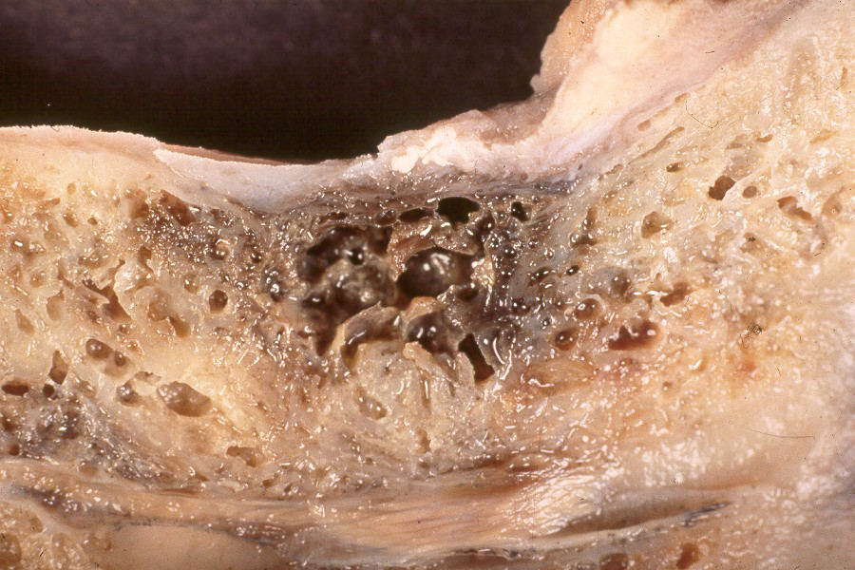
Maxillofacial Osteonecrosis Chronic Ischemic Bone Disease
Multicystic, discolored “mush” of posterior mandible in patient with atypical facial neuralgia/painPhoto: J Oral Pathol Med 1999; 28:423.

Slide 108
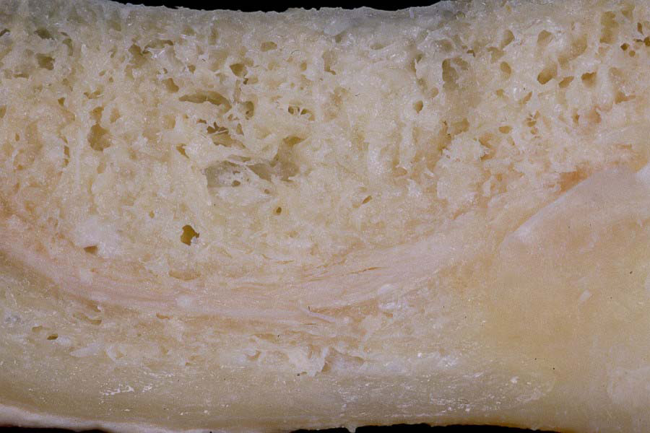
Healthy Bone

Slide 109
Optimal Healing Environment
No Pressure on Surgical Site
Increase Growth Factor and Angiogenesis
Vitamin C and L- GSH to Decrease Oxidative Stress
Vitamin D
Iodine Levels Optimized
Nitric Oxide (Neo40)
Oxaloacetate—BeneGene
Oxygenation—Deep Breathing and decrease Sleep Apnea
Decrease Occlusal Trauma and Stress—Orthodontic Orthopedic Mouth Guard
Increase Hydration with Alkaline Pure Water
Use of Metronidazole
Decrease Gut Inflammation (Phase 3 Dysfunction)

Slide 110
Bone Growth—Dr. Choukroun
Vessels
Collagen
Growth Factors
Bone Activation
Low Contamination
Laser
Shock Wave
Lower LDL
Low Pressure

Slide 111
The CTx Test—Serum C-terminal Telopeptide test
CTx is a medical blood test that is used to assess the risk of oral bisphosphonate-induced osteonecrosis of the jaws and guide treatment decisions.
The test is performed by Quest Diagnostics and the patient must fast 12 hours beforehand.
According to Marx ( J Oral Maxillofac Surg. 2007 Dec;65(12):2397-410.):
“A stratification of relative risk was seen as CTX values less than 100 pg/mL representing high risk, CTX values between 100 pg/mL and 150 pg/mL representing moderate risk, and CTX values above 150 pg/mL representing minimal risk. The CTX values were noted to increase between 25.9 pg/mL to 26.4 pg/mL for each month of a drug holiday indicating a recovery of bone remodeling and a guideline as to when oral surgical procedures can be accomplished with the least risk.”

Slide 112
Patient Responsibility
It is common for most individuals to put off seeing a dentist until they are motivated by tooth or jaw pain or serious medical diagnosis they suspect may be related to their oral health. Even if they are motivated by pain or even to improve function or appearance they may not be completely aware of the extent of their dental condition and require considerable consultation with a qualified dentist who understands the complexities associated with chronic pain and disease.
Healthcare practitioners and patients would agree that any type of chronic pain and chronic disease is a challenging and often frustrating situatio; that is commonly treated primarily with pharmaceuticals which generally produce serious side effects with disappointing long term results.
However, when healthcare advocates work together to create a comprehensive strategy that includes the support and compliance of all concerned related to reducing the total body burden of toxins, infection and other concerns, there is great hope for finding answers and a path back to wellness.
It is an honor to work with so many who embody the same revolutionary spirit of courage and determination to help others achieve their potential for freedom. The mission has always been to provide an educational perspective that allows individuals to personally apply the basic truths or laws of health.
For example, if we reason that one of the rules for health is appropriate hydration, and the tool is pure water then the personal application is what each person needs to keep hydrated based upon unique lifestyle and body size. It becomes our own particular path requiring us to develop our own initiative, intuition, self-discipline, commitment and compliance to those healthier rules.

Slide 113
At Home Pre and Post PRF Healing Modalities and Support Therapy Technology
Medical Dental Coordination
Patient Compliance
Biomodulator Biotransducer Therapy
Nutrition Diet and Supplementation
Neo 40
Iodine
Appropriate Hydration
Ozone Therapy
Quality Sleep
Grinding and Clenching protection
Abstinence from damaging factors i.e; smoking, alcohol, caffeine iced sodas

Slide 114
Mercury and Other Toxic Burdens
Mercury can deplete cellular Tyrosine by Binding to SH Groups and Has a Strong Affinity For Purines for Example:
Vaccinations by age 2 equal 237.5 micrograms or 3.53 X 10 to the 17th (353,000,000,000,000,000) molecules
Thimerosal is 49.6% Ethylmercury by weight
Tyrosine is vital for Thyroid Hormone→ Metabolism→ Healing Potential
Infections from Failing Root Canals and Jaw Bone Infections

Slide 115
WHAT ARE THE PRIMARY CHEMICAL ACTIONS OF MERCURY TOXICITY?
COVALENTLY BINDS TO THE THIOL (-SH) GROUPS OF BIOMOLECULES MODIFYING THEIR ACTIVITY.
DISPLACES OTHER ESSENTIAL METALS (e.g. Zn²⁺, Cu²⁺, Fe²⁺) FROM THEIR NATURAL BINDING SITES.

Slide 116
Major Concept
Primary mercury reactions leading to enzyme abnormalities further leads to destruction of the integrity of cells making up the “bio-membrane” and the loss of this integrity causes “bio-membrane” leakage and a loss of compartmentalization of non-toxic materials and the immune system.
This loss of compartmentalization leads to conversion from non-toxicity and immune protection to toxicity and immune system disorders.
This is not always a simple concept to understand.

Slide 117
The Origin of Bacteria
The oral cavity can be the origin of pathogenic bacteria and inflammatory mediators through the bloodstream, lymph system, tissues, and along fascial planes.⁸
This infiltration triggers both local and systemic responses in the susceptible host. Thus, local and systemic risk assessment of the periodontal patient becomes an important part of overall treatment.⁹
Nagaoka, et al. (1995). Bacterial invasion into dentinal tubules of human vital and non-vital teeth.
J. Endodon. 21: 70-73

Slide 118
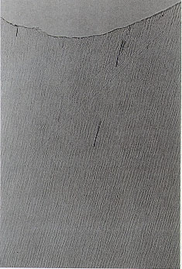
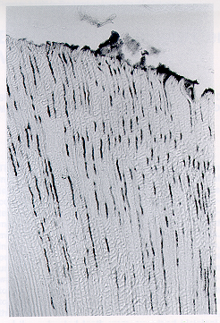

Nagaoka, et al. (1995). Bacterial invasion into dentinal tubules of human vital and non-vital teeth.
J. Endodon. 21: 70-73
Vital Tooth
Non-vital Root Canal Tooth
(Brown-Brenn stain, x200 magnification)
% Invaded Tubules: 1.1% vs. 39.0%
©2011 Jerry Tennant

Slide 119
Inflammation, heat shock proteins and periodontal pathogens in atherosclerosis:an immunohistologic study. Oral Microbiol Immunol. 2006 Aug;21(4):206-11.
CONCLUSION: These results give evidence for a specific immune response associated with atherosclerosis. Whether bacteria initiate the observed inflammation in atherosclerotic lesions is not clear; however, the present study shows that maintenance of inflammation may be enhanced by the presence of periodontopathic bacteria.

Slide 120
Failing Root Canal Treatment
J.F. Siqueira, et. al., Polymerase chain reaction-based analysis of microorgnaisms associated with failed endodontic treatment, Oral Surg Oral Med Oral Pathol Oral Radiol Endod 2004; 97: 85-94
Microorganisms occurred in all cases of root-filled teeth associated with periradicular lesions, which lends strong support to the assertion that treatment failures are of infectious etiology, caused by persistent infections. E. faecalis was by far the most prevalent species.

Slide 121
Mercury and Oral Symptoms
Burning sensation
Chronic coughing
Gingivitis/bleeding gums
Inflammation of the gums
Leukoplakia (white patches)
Metallic taste
Mouth inflammation
Sore throats
Ulcers of oral cavity

Slide 122
Mercury and Other Symptoms
Allergies
Anorexia
Excessive blushing
Genital discharge
Gland swelling
Hair loss
Hypoxia
Illnesses (frequent)
Insomnia
Perspiration excessive
Renal failure
Skin cold and clammy
Skin problems
Vision problems (tunnel vision)
Water retention (edema)

Slide 123
Symptoms of Chronic Mercury Toxicity
Nervous System: Irritability, low concentration, memory loss, insomnia, depression, anxiety, tingling of the extremities, tremors, disturbed sense of smell and taste (metallic taste), unexplained burning sensation or numbness, pain, headaches, fatigue, tinnitus.
Immune System: Chronic or frequent viral, bacterial or fungal (Candida) infections, autoimmune disorders, allergies/hypersensitivities
Cardiovascular: Abnormal heart rhythm, high blood pressure, cardiomyopathy.
Skin: Eczema, allergies.
Endocrine System: Hypothyroidism, hypoglycemia, adrenal disease, infertility.
Gastrointestinal: Food sensitivities, bacterial or fungal overgrowth, recurrent parasitic infections, abdominal cramps, irritable bowl symptoms.
Systemic: Premature aging, fatigue, fibromyalgia.

Slide 124
Problem of Toxicity Diagnosis
Psychological & Behavioral
Anxiety Emotional Instability
Apathy Inability to concentrate
Confusion Psychological disturbances
Depression Lowered Intelligence
Fits of anger Manic Depression
Forgetfulness Lack of self-control
Irritability Short attention span
Hallucinations Short-term memory loss
Nervousness Sleep disturbances
Nightmares Difficulty making decisions
Tension Unexplained suicidal ideas
Oral Cavity
Bad breath
Bleeding gums
Mouth ulcers
Leukoplakia
Stomatitis
Swollen tongue
Loosening of teeth
Loss of teeth
Bone loss around teeth
Increased flow of saliva
Enlarged salivary glands
Burning sensation in mouth
Metallic taste In mouth
Periodontal (gum) disease
Sore throat- persistent cough

Slide 125
Mercury exposure has been linked Lyme disease. Because mercury has such a destructive effect on the immune and detoxification systems, this list could be much longer.
Acrodynia
Alzheimer’s
Anterior lateral sclerosis (ALS)
Asthma
Arthritis
Autism
Candida
Cardiovascular disease
Chronic fatigue syndrome
Crohn’s disease
Depression
Developmental defects
Diabetes
Eczema
Emphysema
Fibromyalgia
Hormonal dysfunction
Intestinal dysfunction
Immune system disorders
Kidney disease
Learning disorders
Liver disorders
Lupus
Lyme disease
Metabolic encephalopathy
Multiple sclerosis (MS)
Reproductive disorders
Parkinson’s disease
Senile dementia
Thyroid disease

Slide 126
How To Improve Optimal Healing Potential
Team with other Health Care Practitioners that Provide Alternative Help; Prescribe and Assess lab results, Reinforce Pre and Post Surgical Instructions Patient Compliance. Including the Patients Ability to Assimilate Nutrients and Eliminate Toxins. Identify and Eliminate Potential Blockages and Concerns Such As :
Assess Cardiovascular, Oxygen, Exercise, Gastrointestinal Function and Circulation Health
Assess Mineral and Vitamin Levels and Nutrition with appropriate, fats, protein, carbohydrates
Assess Oral Health and Remove all Metal and Sources of Infection and Heavy metals
Assess and Correct Dehydration
Assess and Balance Autonomic Nervous System Ability to Rest and Digest Balance
Identify Cause, Eliminate Source and Treat Chronic Pain
Assess and Restore Endocrine System Function and Hormonal imbalances
Assess Vitamin and Mineral levels and Address Nutrition and Ability to Assimilate Nutrients
Identify and Eliminate Toxic Sources
Assess and support the lymphatic’s
Assess and address structural issues
Investigate and Resolve Negative Geopathic and Electro-magnetic Exposures
Physical and Emotional Scars
Assess Causes for Sleep Deprivation and Sleep Apnea
Identify Emotional Trauma, Mood Disorders, Provide Stress Relief Management
Assess Mitochondria Function
Identify and Eliminate Other Infections in the body
Identify Appropriate Detoxification, Fasting and Cleanses

Slide 127
Continuing Education
Biological, Alternative, Integrative Dental Practices
Alternative Health Practices
Nutrition, Diet and Exercise
Supplementation—vitamins and minerals
Energetic Medicine
Acupuncture
Antimicrobial Herbs and Spices
Essential Oils
Lymphatic Massage
Homeopathies
Ozone Therapy
State of -the-art surgical equipment, instruments and minimally invasive technics
Imaging Capabilities such as 3D Cone Beam Scans
Alternative Materials and Products
Effective Surgical Procedures such as PRF

Slide 128
Glossary Of Terms

Slide 129
Platelet Derived Growth Factors
Growth Factors that Regulate Cell Growth and Division Effects Tissue Osteoblasts, Fibroblasts, Smooth Muscle, and Tenocytes (Tyrosine Kinase)
PDGF- ABCD
RA and RB
FIGF
PGF
VEGF, VEGF 41 VEGF-B and VEGF-C

Slide 130
Vascular Endothelial Growth Factor
Protein with Disulfide Linkage To Stimulate Vasculogenesis and Angiogenesis, Restoring Oxygen (High in Bronchial Asthma, Low in Diabetes)(Tyrosine Kinase)
VEGF-A: Angiogenesis Chemotactic for Macrophages and Granulocytes, Vasodilation indirectly by NO Release (Nitric Oxide)
VEGF-B: Embryonic Angiogenesis
VEGF-C: Lymphangiogenesis
VEGF-D: Developing Lymphatic Vasculature Around Lung Bronchials
PIGF: Vasculogenesis and Angiogenesis During Ischemia Inflammation and Wound Healing

Slide 131
Transforming Growth Factors
Bone Morphogenetic Proteins* Osteogenesis Cell Differentiation in Growth Homeostasis (Serine/threonine kinase)
TGF Beta 1, 2, 3: Embryogenesis and Cell Differentiation Apoptosis, neogenesis
Activin A, B, AB: Embryogenesis and Osteogenesis, Regulating Hormones (Pituitary, Gonadal, Hypothalamic, Insulin, and Nerve Cell Survival Factors)
BMP 1: Matalloprotease that Acts on Procollagen I, II, III Involving Cartilage Development
*BMP 2, 3, 4, 5, 6, 7, 8A, 8B, 10, 15: Formation of Bone and Cartilage, are Cytokines and as Metabologens

Slide 132
Insulin-like Growth Factors
IGF: Cell Environment – Communication (Tyrosine Kinase)
IGF 1R, 2R, 1, 2
IGF Binding Protein
IGFBP 1-6
Proteases

Slide 133
Hepatocyte Growth Factor
HGF—Acts Upon Epithelial and Endothelial Cells Adult Organ Regulation and Wound Healing, Beta Tubulin (Tyrosine Kinase)

Slide 134
Epidermal Growth Factor
EGF—Submandibular Salivary Glands, Parotid Glands (Tyrosine Kinase)
SEGF: Salivary Epidermal Growth Factor is regulated by dietary inorganic iodine to maintain oro-esophegeal and gastric tissue integrity

Slide 135
Fibroblast Growth Factors
FGF—22 Types Acidic and Basic (FGF 1, FGF 2 Promotes Endothelia Cell Organization to a Tube Like Structure Angiogenesis and is More Potent than VEGF and PDGF (Tyrosine Kinase)

Slide 136
Connective Tissue Growth Factor
CTGF—Secreted by Endothelial Cells for Cell Adhesion (Cysteine Dominate Sites)

Slide 137
“Chesed” = Kind
To Provide What is Needed

Slide 138
Truth Speakers Providing What is Needed
Dr. Nathan Bryan
Dr. Dean Bonlie
Bill Henderson
Dr. Frank Shallenberger
Dr. Brad Bale
Amy Doneen
Dr. Jerry Tennant
Dr. Dawn Ewing

Slide 139
A-PRF Process
Contact Information:
Process
49 rue Gioffredo
06000 Nice, France
Phone: +33-0-4 93 85 58 90
Fax: +33-0-957 333 256
www.Prf-process.com

Slide 140
Intra-Lock
Contact Information:
GLOBAL HEADQUARTERS
6560 West Rogers Circle, Bldg. 24
Boca Raton, Florida 33487 USA
Telephone: 877-330-0338
Website: www.intra-lock.com
Intra-Lock® , is a Registered Trademark of Intra-Lock® International, Inc.
IntraSpin™, L-PRF™ and logo, and Xpression™ are trademarks of Intra-Lock® International Inc.
Vacuette® is a registered trademark of Greinger Bio One AG.
U.S. and Worldwide Patents Pending
EC Rep:
Intra-Lock System Europa, Spa
Via Fabrizio Pinto, 16, I-84100 Salerno - Italy
©Copyright 2013, Intra-Lock®
System International • S4EN-13-4

Slide 141
DentalXp
Contact Information:
Tyler Binner
600 Galleria Pkwy Suite 800
Atlanta, GA 30339
678-872-7774
tyler@dentalxp.com

Slide 142
BTI Biotechnology Institute
USA Contact Information:
BTI Biotechnology Institute
PRGF-Endoret
1730 Walton Road Suite 110
Blue Bell, PA 19422
215-646-4067
Info@/BTI-implant.us

Slide 143
CGF—Medifuge—Silfradent srl
Contact Information:
GDiVittario 35/37
47018 S. Sofia(fc) Itailia
Sofio, Italy
Phone: 39-0-543970684
Fax: 39-0-543970770

Slide 144
Continue the Conversation with
Dr. Evans
Stephen R. Evans DDS
PO Box 970
Bullard, Texas 75757
903-825-7400
Jawrestoration1@gmail.com
www.healthiersmilesdental.com
www.healthiersmilesimaging.com

Slide 145
References and Research
1. Dohan Ehrenfest DM, Del Corso M, Diss A, et al. Three-dimensional architecture and cell composition of a Choukroun’s platelet-rich ﬁ brin clot and membrane.
J Periodontol. 2010 Apr;81(4):546-55.
2. Dohan Ehrenfest DM, Del Corso M, Diss A, et al. Three-dimensional architecture and cell composition of a Choukroun’s platelet-rich ﬁ brin clot and membrane. J Periodontol. 2010 Apr;81(4):546-55.
3. Dohan DM,, Diss A, Dohan SL, Dohan AJ, et al. Platelet-rich ﬁ brin (PRF): a second-generation platelet concentrate. Part III: leucocyte activation: a new feature for platelet concentrates? Oral Surg Oral Med Oral Pathol Oral Radiol Endo. 2006 Mar;101(3):e51-5.
4. Michael Tofﬂ er, Nicholas Toscano, Dan Holtzclaw, DDS, et al.Introducing Choukroun’s Platelet Rich Fibrin (PRF) to the Reconstructive Surgery Milieu. J Implant & Adv Clin Dent. 2009 Sept; 1(6): 21-32.
5. Simonpieri A, Del Corso M, Vervelle A, Jimbo R, et al. Current knowledge and perspectives for the use of platelet-rich plasma (PRP) and platelet-rich ﬁ brin (PRF) in oral and maxillofacial surgery part 2: Bone graft, implant and reconstructive surgery. Curr Pharm Biotechnol 2012 Jun;13(7):1231-56.
6. Del Corso M, Mazor Z, Rutkowski JL, et al. The use of leukocyte- and platelet-rich ﬁbrin during immediate postextractive implantation and loading for the esthetic replacement of a fractured maxillary central incisor. J Oral Impl 2012 Apr;38(2):181-7.
7. Jain V, Triveni MG, Kumar AB, Mehta DS. Role of platelet-rich-ﬁ brin in enhancing palatal wound healing after free graft. Contemp Clin Dent. 2012 Sep;3(Suppl 2):S240-3.
8. Soadoun AP, Touati B. Soft tissue recession around implants: Is it still unavoidable? --Part II. Pract Proced Aesthet Dent. 2007 Mar;19(2)81-7

Slide 146
Excerpts From PRF Plastic Surgery Article
PRF was first developed in France by Choukroun et al. in 2001. It can be considered as a second-generation platelet concentrate because the natural concentrate is produced without any anticoagulants or gelifying agents. 13
Therefore, this second-generation platelet concentrate eliminates the risk associated with the use of bovine thrombin. These technologies were tested in many different clinical fields, particularly oral and maxillofacial surgery, ear-nose-throat (ENT) surgery, ophthalmology, gynaecology, cardiovascular surgery, sports medicine, orthopedic surgery and plastic surgery 14

Slide 147
Classification of PRF
Choukroun’s PRF (L-PRF) is the latest development of platelet concentrates protocols. In this protocol, blood is collected without any anticoagulant and immediately centrifuged. A natural coagulation process then occurs and allows for the easy collection of a leucocyte- and PRF (L-PRF) clot, without the need for any biochemical modification of the blood, so no anticoagulants, thrombin or calcium chloride are required. This open-access technique is the most simple and also the least expensive protocol developed so far. However, some confusion is likely because different suppliers use similar
nomenclature for their distinct products, such as Vivostat PRF and Fibrinet PRF Matrix (PRFM). Therefore, Ehrenfest et al. present classifications of the different platelet concentrates into
four categories, depending on their leucocyte and fibrin content: pure platelet-rich plasma (P-PRP), such as cell separator PRP, Vivostat PRF or Anitua’s PRGF; leucocyte- and platelet-rich plasma (L-PRP), such as Curasan, Regen, Plateltex, SmartPReP, PCCS, Magellan or GPS PRP; pure platelet-rich fibrin (P-PRF), such as Fibrinet PRFM; and leucocyte and PRF (L-PRF), such as L-PRF15,16. This classification should help us to elucidate successes and failures that have occurred so far, as well as providing an objective approach for the further development of these techniques.

Slide 148
Classification of PRF
The topical use of platelet concentrates is recent and its efﬁciency remains controversial. Several techniques for platelet concentrates are available; however, their applications have been confusing because each method leads to a different product with different biology and potential uses.
Here, we present classiﬁcation of the different platelet concentrates into four categories, depending on their leucocyte and ﬁbrin content: pure platelet-rich plasma (P-PRP), such as cell separator PRP, Vivostat PRF or Anitua’s PRGF; leucocyte- and platelet-rich plasma (L-PRP), such as Curasan, Regen, Plateltex, SmartPReP, PCCS, Magellan or GPS PRP; pure plaletet-rich ﬁbrin (P-PRF), such as Fibrinet; and leucocyteand platelet-rich ﬁbrin (L-PRF), such as Choukroun’s PRF.
This classiﬁcation should help to elucidate successes and failures that have occurred so far, as well as providing an objective approach for the further development of these techniques.

Slide 149
Preparation of PRF
Unlike other platelet-rich products, the technique requires neither an anticoagulant nor bovine thrombin (or any other gelling agent). It is nothing more than centrifuged blood without any addition. The PRF protocol is very simple: a blood sample is taken without anticoagulant in 10-mL tubes, which are immediately centrifuged at 3000 rpm (approximately 400g) for 10 min (Process protocol, Nice, France)^{[13]}. The resultant product consists of the following three layers: the topmost layer consisting of acellular PPP, PRF clot in the middle, RBCs at the bottom.

Slide 150
Preparation of PRF
The absence of anticoagulant implies the activation in a few minutes of most platelets of the blood sample in contact with the tube walls and the release of the coagulation cascades. Fibrinogen is initially concentrated in the middle and upper part of the tube before the circulating thrombin transforms it into fibrin.
A fibrin clot is then obtained in the middle of the tube, just between the red corpuscles at the bottom and acellular plasma at the top17. The PRF clot forms a strong fibrin matrix with a complex three-dimensional architecture, in which most of the platelets and leucocytes from the harvested blood are concentrated^{[18,19}

Slide 151
Preparation of PRF
The success of this technique entirely depends on the speed of blood collection and transfer to the centrifuge. Indeed, without an anticoagulant, the blood samples start to coagulate almost immediately upon contact with the tube glass.
Quick handling is the only way to obtain a clinically usable PRF clot. If the duration required to collect blood and launch centrifugation is overly long, failure will occur: The fibrin will polymerize in a diffuse way in the tube and only a small blood clot without consistency will be obtained^{[13]}.

Slide 152
PRF
Sometimes, a PRF membrane was needed in the applications of oral^{[20]}, maxillofacial^{[21,22]}, ENT^{[23]} and plastic surgery^{[24]}. The centrifuged PRF clot was picked up, and the red thrombus was eliminated along the border between this fraction and the PRF. Then, the PRF was usually compressed by dry gauzes, which became a strong
Compared to the PRF membrane compressed by dry gauze (G-PRF), the preservation of the plasma content, 3D-fibrin meshwork and platelets was more intact in the compressor-prepared PRF membrane (C-PRF). Among the growth factors tested, C-PRF contained PDGF isoforms at higher levels, and significantly stimulated cell proliferation and neovascularization. Therefore, PRF compressed by this compression device may be useful for grafting while minimizing the loss of bioactive factors^{[25]}

Slide 153
Applications of PRF in Plastic Surgery
Recently, L-PRF and PRFM (P-PRF) were both applied in plastic surgery, and the applications can be divided into two aspects: facial plastic surgery and wounds healing (including surgical wounds, recalcitrant wounds, skin autografts, skin flap and so on).

Slide 154
The haemostatic, fibrogenic and angiogenic properties of PRF have been used in procedures such as rhytidectomy, rhinoplasty and facial implants, in which rapid healing, minimal edema and reduction of ecchymosis are desired.
P-PRF: Sclafani et al. reported the applications of PRFM in facial plastic surgery, including periorbital treatments (crow’s feet, tear troughs, suborbital hollows and glabellar furrows), midface and lower face treatments (malar augmentation, zygomatic arch enhancement, nasolabial folds, acne scars and boxcar acne scars) and adjuvant use of facial plastic surgery (facelift, rhinoplasty and facial implants)^{[26,27,28]}. Finally, only a small percentage (10% or less) of patients do not generate a tissue response sufficient to produce a clinically acceptable result.
Because of the angiogenic abilities, PRFM has been co-injected during autologous fat transfer to enhance the viability and survival of the fat^{[26]}. Evidence from the work of Sclafani and McCormick suggests that PRFM can also induce an anabolic state in mature fat as well as potentially promoting more rapid vascularization of the transferred fat^{[29]}. PRFM is a significant new tool during minimally invasive as well as open surgical procedures.
However, once activated by calcium in the second tube during the preparation, PRFM begins to undergo fibrin polymerization. After 10 to 12 min, it is no longer possible to inject PRFM. Therefore, if using multiple tubes, activate only one at a time to avoid polymerization before use is necessary. PRFM must rely on the local tissues’ ability to generate a cellular response, and may not be as effective in unfavourable wound conditions such as hypoxia or infection^{[26]}.

Slide 155
PRF in Wound Healing
In the clinic, a mount of literatures reported the effect of PRF in wound healing. Lundquist et al. suggested that the L-PRF could be beneficial for the healing of recalcitrant wounds by investigating the characteristics of L-PRF^{[33]}. Jorgensen et al. also suggested the consistent results.
A pilot trial on 15 patients, with 16 lower extremity chronic wounds of varying aetiologies, has been performed with a positive outcome^{[34]}. Chignon-Sicard et al. investigated the efficacy of L-PRF in a randomized controlled clinical trial (RCT) of wound healing and demonstrated that a single L-PRF application on fresh postoperative hand wounds shows a median improvement of 5 days in comparison with the standard treatment^{[35]}.

Slide 156
Problems of PRF
This field of research unfortunately suffers from the lack of a proper accurate terminology and the associated misunderstandings, and the literature on the topic has been quite contradictory in the past, leading to many confusions in the scientific database. However, the future of this field is first dependent on the coherence and scientific clarity^{[14]}. The classification presented by Dohan Ehrenfest et al. may be the key to solve this problem.
This technological classification aimed to provide an overview of the available systems and to categorize them with respect to three main parameters: fibrin density, leucocyte content and degree of standardization of the procedure^{[15,16]}. A terminology consensus can facilitate researchers to be aware of the complex nature of these living biomaterials, in order to avoid misunderstandings and erroneous conclusions.

Slide 157
Antimicrobial Effects ?
The question of the leucocyte content within platelet concentrates for surgical use is in fact an old debate. There is however actually no proof that the leucocytes within these surgical preparations might have undesirable side effects. On the contrary, several studies showed that L-PRPs have antimicrobial effects^{[36]}, but no undesirable inflammatory reactions have been observed with L-PRPs up to now, even in immune-sensitive applications^{[37,38]}.
The influence of leucocytes injected with surgical platelet concentrates is actually a relevant way of research^{[39]}, and no author can claim that their influence is negative. All statements on this matter should be carefully and scientifically discussed and proven^{[40]}. It is now important to demonstrate the influence of the leucocytes on the biology of each product and its potential benefits should now be carefully analyzed because it could explain many controversial data from the literature.

Slide 158
PRFM
PRFM (P-PRF) fundamentally differs from other PRP systems in that it promotes the physiologic functions of fibrin and avoids the potential drawbacks of included leucocytes. However, the simultaneous processing of large sample numbers with the Fibrinet method remains difficult and is expensive in daily practice.
The so-called potential drawbacks of leucocytes are also lack of evidences and indeterminate. The development of PRFM may be limited in daily practice in future.

Slide 159
Prospection
PRF is an immune and platelet concentrate, collecting all the constituents of a blood sample favourable to healing and immunity on a single fibrin membrane.
PRF allows the surgeon to directly deliver a concentrated and functional wound healing response to a target area, which can enhance the patient’s natural wound healing ability. PRF can stimulate the production of viable blood vessels, fat cells and collagen deposits that seem to persist over time even without a wound.

Slide 160
L-PRF
L-PRF allows the production of a high quantity of L-PRF clots simultaneously using either a specific centrifuge that takes eight tubes or any modified laboratory centrifuge, making it possible to produce even more clots for larger surgeries. Another advantage of L-PRF is its low cost and the great ease of the procedure, which allows the production of many concentrates quickly and by natural means, that is, without the use of chemicals or unnatural conditions.
Finally, expensive and complex procedures are often unusable in daily practice and many will disappear. Simple and free systems, such as L-PRF, were developed by clinicians for clinicians and are anticipated to be major methods in the next years. Therefore, L-PRF seems to be most suitable for widespread use in daily practice and is actually the main technique in some countries, including France, Italy, Israel and so on.

Slide 161
Further Studies
However, some literatures presented no significant negative effect of PRF in wound healing^{[41,42]}. Further studies are necessary to validate the interest of the PRF in plastic surgery.
The potential uses in plastic surgery of such a biomaterial, easy and fast to produce, without any high cost and with no risk, are very numerous and require from now on to be tested and validated methodically.

Slide 162
Conclusion
PRF is the new generation platelet concentrate. PRF could be classified into two categories depending on its leucocyte content: P-PRF and L-PRF. PRF is obtained centrifugally by autologous peripheral blood, without adding any biological agents. PRF contains fibrin matrix polymer, leucocytes, cytokines and circulating stem cells.
Because PRF is low in cost and is easily available, it has been applied in many different clinical fields, particularly oral and maxillofacial surgery, orthopaedic surgery and plastic surgery. L-PRF and P-PRF (PRFM) are both applied in plastic surgery and the applications can be divided into two aspects: facial plastic surgery and wound healing.
However, the role of the leucocyte content within platelet concentrates for surgical use is still unclear. Therefore, further studies are necessary to unleash the confusion of PRF in plastic surgery

