Slide 1
Restoring the Methionine Synthase Enzyme Presenter: Benjamin Lynch, ND International Academy of Biological Dentistry and Medicine Conference Las Vegas, NV

Slide 2
Disclaimer & Disclosures
The information presented here is for informational and educational purposes only. Docere, Inc and Benjamin Lynch will not be liable for any direct, indirect, consequential, special, exemplary, or other damages arising from the use or misuse of any materials or information published.
President and CEO of SeekingHealth.com, SeekingHealth.org and founder of MTHFR.Net

Slide 4
Nitrous Oxide

Slide 6
Nitrous Oxide as Anxiolytic
Use alternatives (recommend on website & have on hand in office)
Flat screen on ceiling
Colorful walls, artwork, photography
Music of the patient’s choice
Rescue Remedy
Five Flower Formula by Dr Bach
Calms Forte by Hyland’s (adult and kid versions)
Squishy ball
Prize afterwards – toy
Story
Friendly doc – in lobby: casual photos sailing, hiking, traveling, family
Great staff
Protein breakfast and lunch
No caffeine (recommend alternatives)
Magnesium, GABA, B6
Homeopathics – specific for the patient – have a list on website

Slide 7
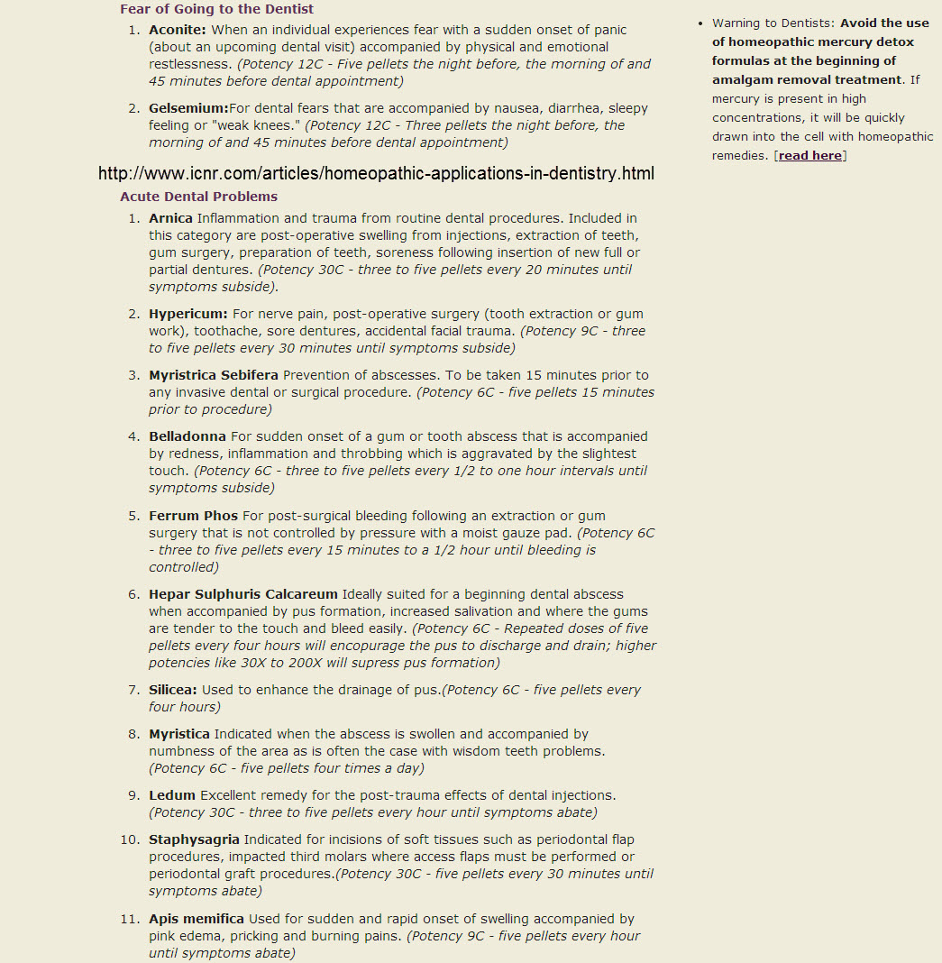

Slide 8
Nitrous Oxide

Slide 9
Nitrous Oxide Safety
Follow guidelines closely
Inspect equipment
Lowest amount possible
Use intermittently

Slide 10
Patient Evaluation

Slide 11
Nitrous Oxide Safety Screening
Team Care – Request Charts Prior to Treatment
One Page Summary
History
Current Medications (including OTC)
Diagnoses
Recent Lab Findings

Slide 12
At-Risk Populations for Nitrous Oxide
Conditions
Pregnant
IBD
Mental dysfunction
Autism
Cancer
Children
Geriatric
Hispanic, Chinese, Italian descent
Reflux
Lyme, H pylori, Candida, EBV, Hep, Strep
Autoimmune
Neurological disorders
Cardiovascular disorders
Lifestyle
Vegan
Vegetarian
Premier Athlete

Slide 13
At-Risk Populations for Nitrous Oxide
Oxidative Stress > Glutathione Deficiency & Cell Membrane Damage
Inflammation > TNFa
Pathogens > Candida, viral infxns, h pylori . . .
Heavy Metals
MTHFR
MTR
MTRR
GSTM1, GSTT1, GSTP1
Low or high homocysteine
Methionine deficiency
SAMe deficiency
B12 deficiency
MTHF deficiency
B2 deficiency
B3 deficiency
B6 deficiency
Selenium deficiency
Cysteine deficiency
Glycine deficiency
Glutamate deficiency

Slide 14
Support Pathways

Slide 15
What is affected?

Slide 17
How to Support? Top 3 are . . .

Slide 18
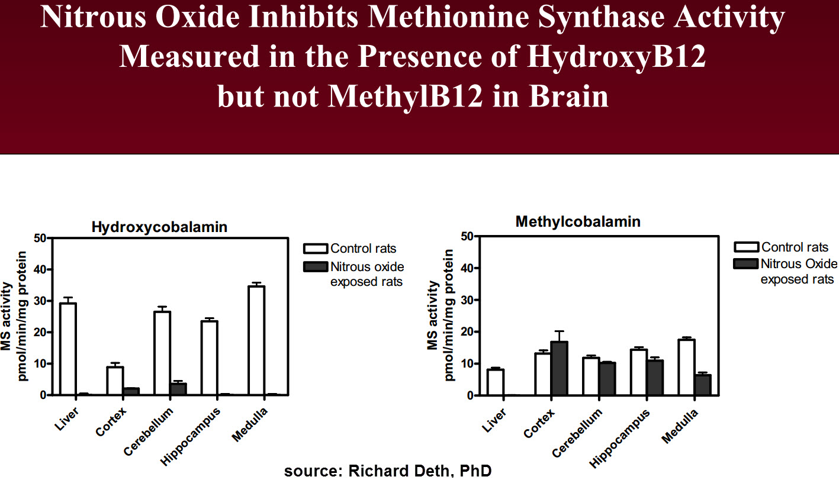
Cyanocobalamin – ok?

Slide 19
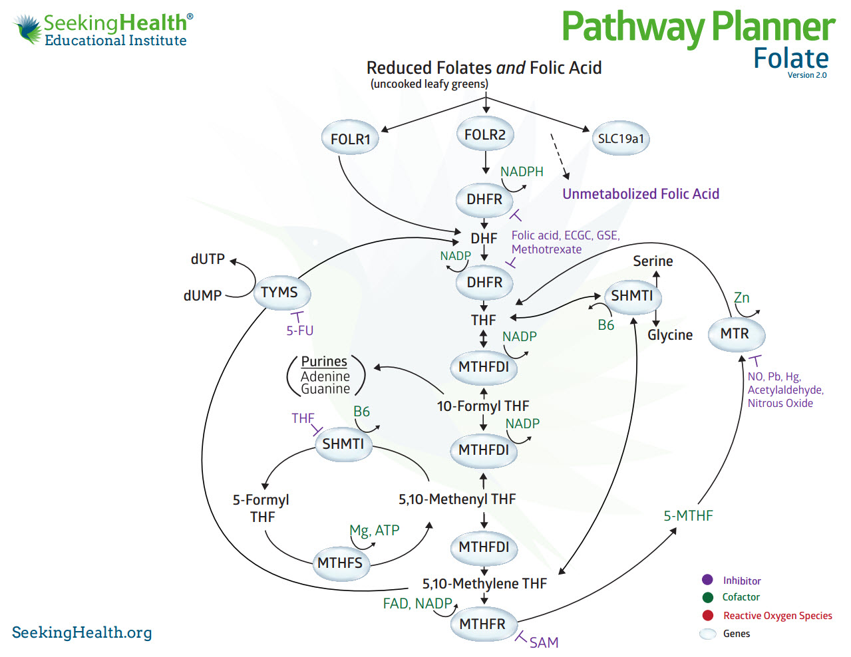
Should we use folic acid?

Slide 20
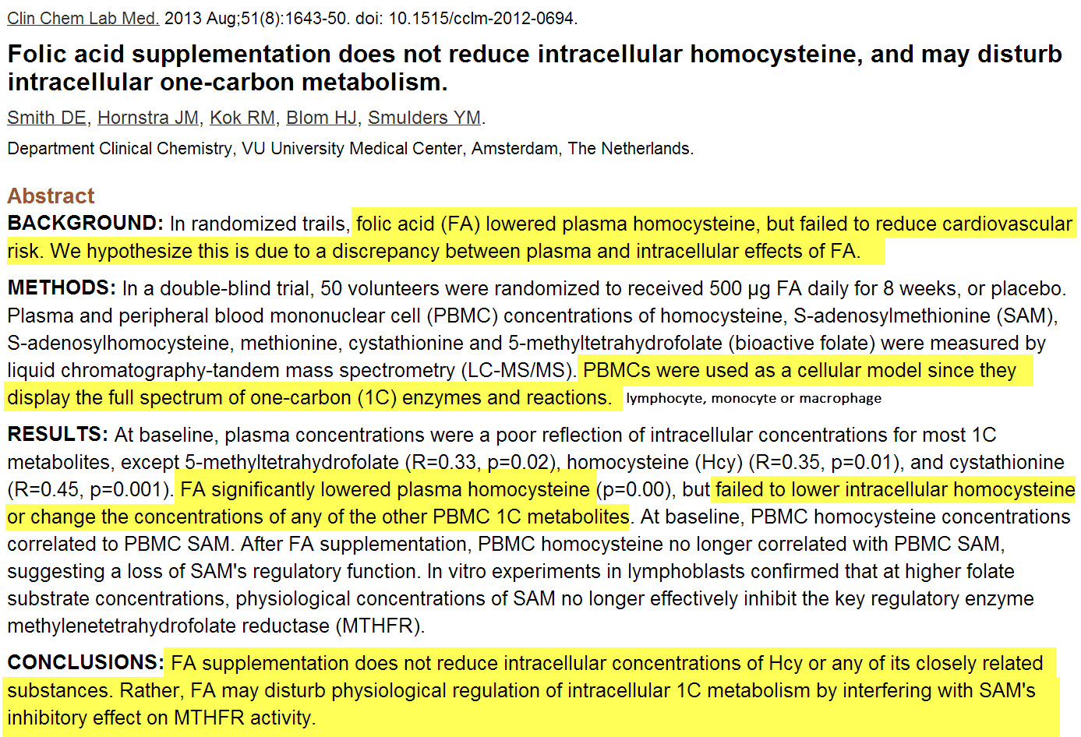
Contribution from Adam Rinde, ND

Slide 21
Pre-Op Support
Week Prior:
Liposomal glutathione – start low and work up
Upon rising
Few drops progressing to 1 to 2 tsp QD
Molybdenum prn
Liposomal vitamin C
Upon rising with liposomal glutathione
1 tsp BID bid ic
Methylcobalamin with methylfolate lozenge – start low and work up
After breakfast
¼ lozenge to full QD
Ideal: combined with adenosylcobalamin
Boswelia serrata gum resin extract (AKBA) OR Liposomal curcumin
100 mg TID ic OR 1 tsp ic with lipo C and GSH
Adaptogens
Ashwagandha, Eleuthro, Avena
Magnesium glycinate
150 mg BID anytime
Multimineral/multivitamin

Slide 22
Pre-Op Support

Slide 23
Glutathione Key Points

Slide 24
Op Support
Morning of and Post-Op:
Liposomal glutathione
1 tsp or use highest tolerated dose
Liposomal vitamin C
1 tsp
Methylcobalamin with methylfolate lozenge
¼ lozenge to full – use highest tolerated dose
Ideal: combined with adenosylcobalamin
Boswelia serrata gum resin extract (AKBA) OR Liposomal curcumin
100 mg OR 1 tsp ic with lipo GSH and C
SAMe
250 mg to 500 mg ic
Adaptogens
Ashwagandha, Eleuthro, Avena
Magnesium glycinate with P5P
Protein breakfast – eggs or smoothie with protein powder
Multivitamin/multimineral

Slide 25
Systems Approach

Slide 26
Interventions
Implement on all patients
Breathing
Sleep schedule
Filtered water
Caffeine free or greatly reduce
Smaller yet more frequent whole food meals with protein, veggies, good carbs
Gluten and dairy free three week trial then challenge one at a time
Chewing
Read: The Metabolic Makeover
CoQ10
Boswelia AKBA or Liposomal Curcumin
Liposomal Glutathione
Multi
Probiotic
D3
Adaptogens
Adrenal cortex
Exercise – rebounder, weights, resistance, yoga, Zumba
Sauna
Potassium
Magnesium

Slide 27
Steps of Treatment
No Protocol – Think Systems – Do NOT Treat the SNP
Remove causes and exposures
Food, Lifestyle, Environment, Social, Hobby, Employment, Meds, Supplements
Basic Foundational Support
Food, Sleep, Hydration, Breathing, Exercise, Social, Nutritional
Identify all areas of dysfunction
GI, adrenals, mitochondria, liver, cell membranes
Pathogens
CDSA, OAT, Total IgG, IgM, IgE
Labs
CBC w chem panel, urinary hormones, serum ferritin, TNFa, ION
Methylation profile

Slide 28
Key Lab Findings
Common findings
Lactate
Ammonia
Urinary MMA
SAH
SAM
MCV and MCH
Serum ferritin
Estrogens
RBC magnesium
RBC folate
RBC zinc
RBC manganese
Arsenic
Glutathione
Homocysteine
Vitamin D3
Serum folate
Serum B12

Slide 29
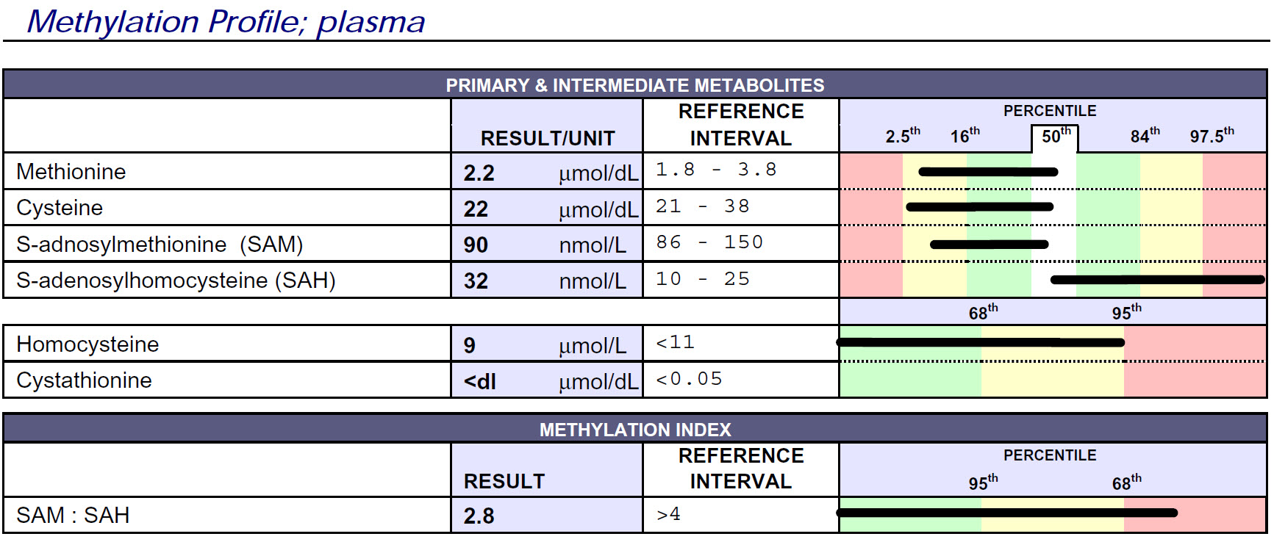
Oxidative Stress & Mitochondrial Screening
Glutathione Levels
Enzyme Upregulation
Ammonia Levels
Vitamin Levels
Test available through Doctors Data

Slide 31
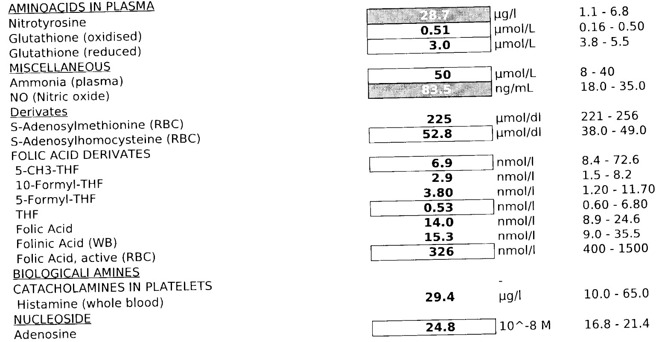
Test available through Health Diagnostics Lab
http://www.hdri-usa.com/tests/methylation/

Slide 33
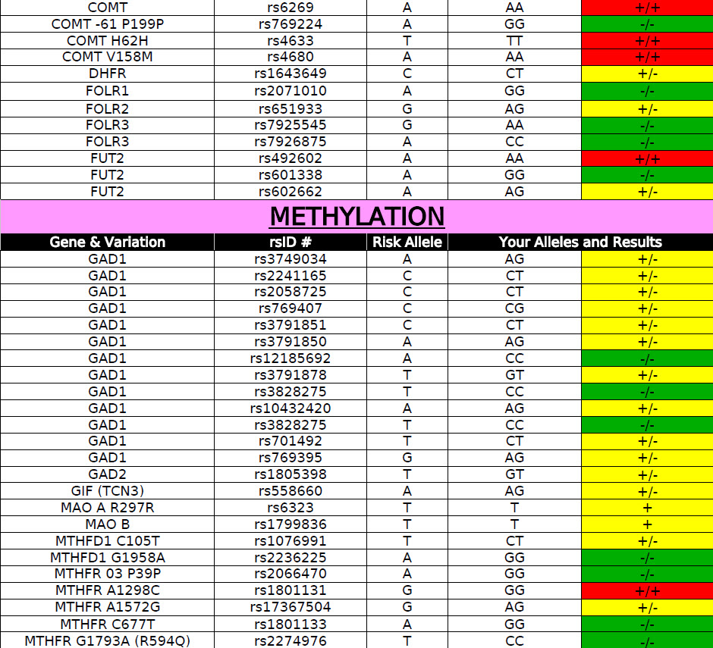

Slide 34
What else?

Slide 35
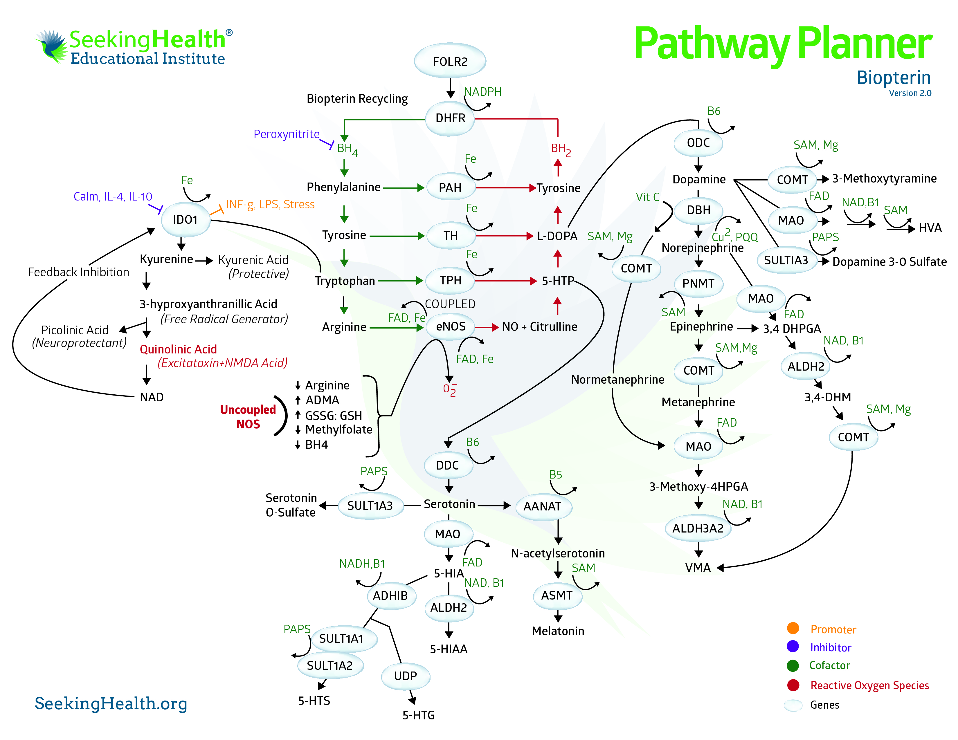

Slide 36
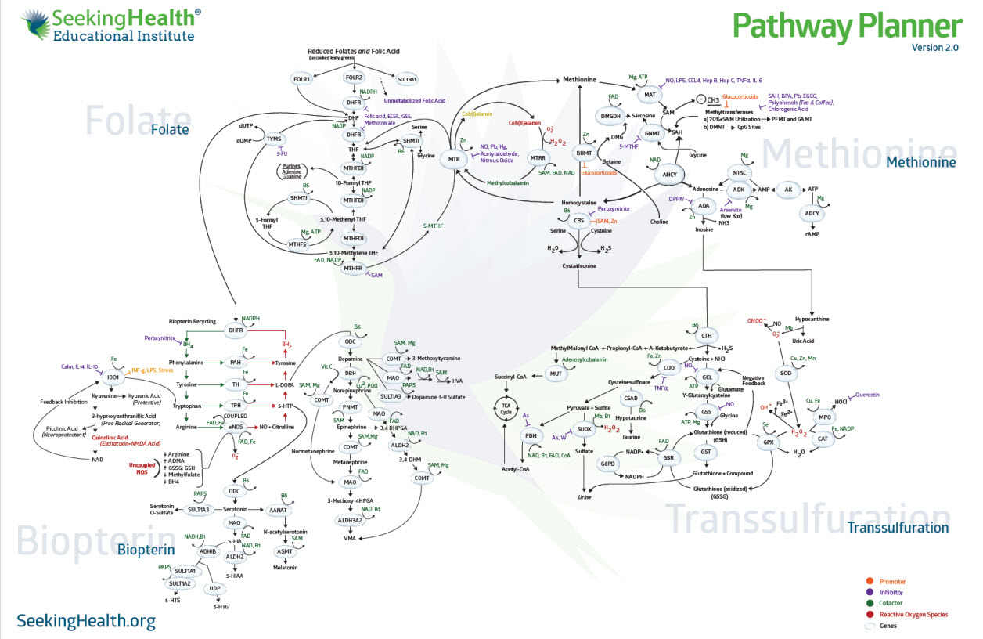

Slide 37
Key Points to Take to the Clinic
Use alternatives to nitrous oxide and acetaminophen
Inform
Prepare
Team care
Methylcobalamin with methylfolate
Glutathione
Curcumin and/or Boswelia
Identify obstacles and remove
Foundation
Pathways and Systems – NOT Protocols or SNPs

Slide 39
Thank you
Great ways to stay informed:
Newsletter Available at www.MTHFR.net
Facebook: https://www.facebook.com/drbenjaminlynch
October 2013 Nutrigenomics Conference www.SeekingHealth.org
March 2014 Nutrigenomics Conference – www.SeekingHealth.org
Pathway Planner Poster and Set – www.SeekingHealth.org
Physician’s Forum for Collaboration – www.SeekingHealth.org
Notes:
If our environment and diet are healthy – then the MTHFR SNP is not so significant.

