Slide 1
MTHFR: Impact of Nitrous Oxide Presenter: Benjamin Lynch, ND International Academy of Biological Dentistry and Medicine Conference Las Vegas, NV “Clinicians will be central to helping consumer-patients use genomic information to make health decisions.” – NEJM

Slide 2
Disclaimer & Disclosures
The information presented here is for informational and educational purposes only. Docere, Inc and Benjamin Lynch will not be liable for any direct, indirect, consequential, special, exemplary, or other damages arising from the use or misuse of any materials or information published.
President and CEO of SeekingHealth.com, SeekingHealth.org and founder of MTHFR.Net

Slide 3
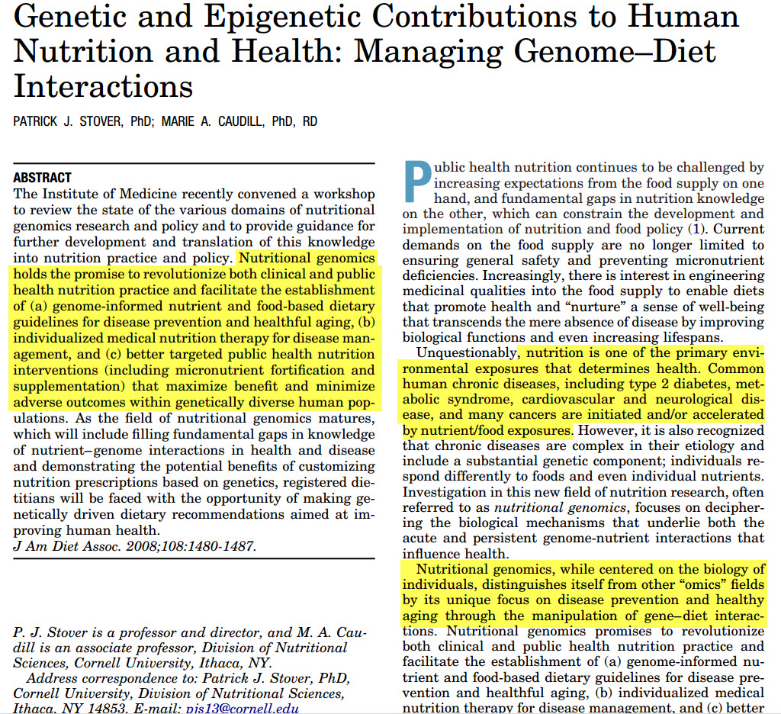

Slide 5
Methylation
Donating Methyl Groups
CH₃

Slide 6
Methylation is the process of controlled transfer of a methyl group (CH₃) onto amino acids, proteins, enzymes, and DNA in every cell and tissue of the body . . .
This process is one of the essential metabolic functions of the body and is catalyzed by a variety of enzymes.
http://www.hdri-usa.com/tests/methylation/

Slide 7
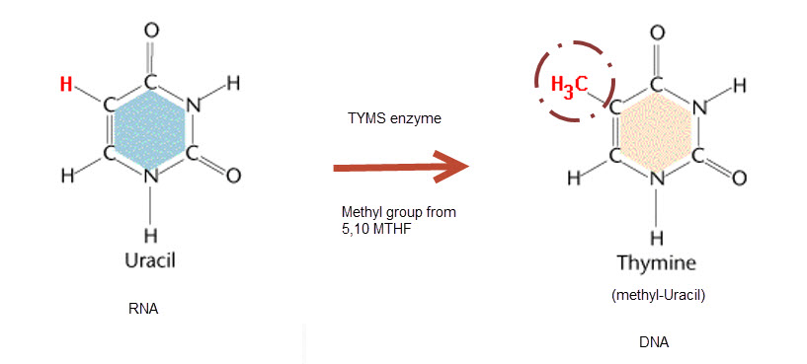

Slide 8
Methylation
Functions of Methylation (some):
Gene regulation: turn on/off genes via SAMe
Biotransformation: glutathione production
DNA base formation: uracil → thymine
Neurotransmission
Cell membrane: phosphatidylcholine and DHA to membranes
Adenosine as metabolic fuel regulator (acetyl CoA vs lactate)
Cell protection: NFKB expression to reduce TNF cytotoxicity
http://www.ncbi.nlm.nih.gov/pubmed/24224954

Slide 9
Methylation
Methyl Donors – donate a methyl group - CH₃
Methylcobalamin (B12)
Methylfolate (Folate)
Methionine
Choline
Glycine
TMG
DMG

Slide 11
“SAM, a remarkably versatile molecule, is said to be second, only to ATP, in the number of enzymes that require it.”
http://jn.nutrition.org/content/136/6/1636S.full.pdf

Slide 13
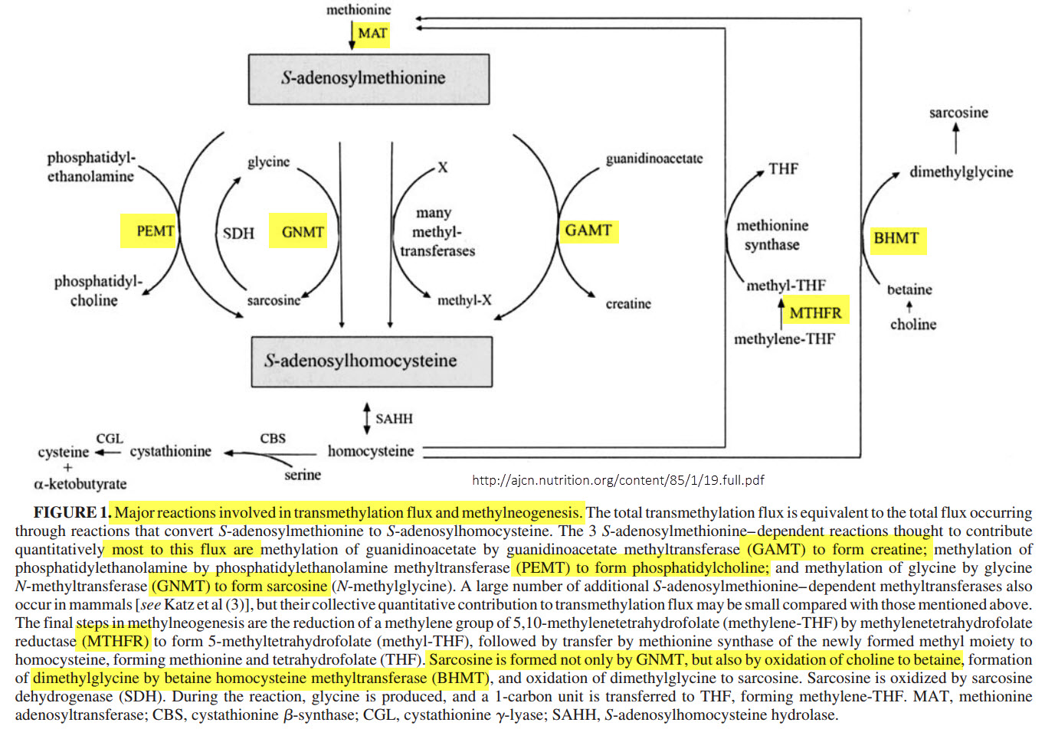

Slide 14
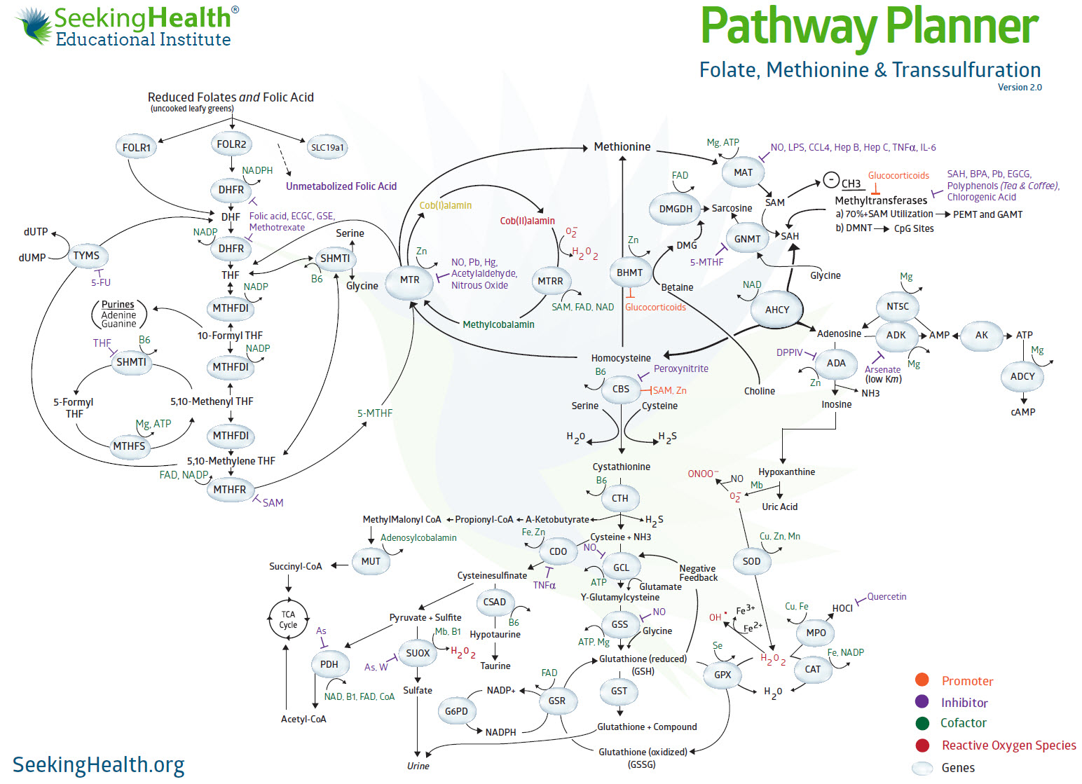
MTHFR snp can reduce one type of cancer risk. Which one?
(Methotrexate Site)
(5-FU site)

Slide 15
Nitrous Oxide
Bad?

Slide 17
“The effect is well known among
anesthetists that nitrous oxide
irreversibly inactivates cob(I)alamin, the active form of vitamin B12 essential for methionine-synthase activity in the brain and converts it to cob(II)alamin.”
http://download.thelancet.com/pdfs/journals/lancet/PIIS0140673605759742.pdf?id=aaaZMYMo1O9384ndqawFu

Slide 18
Nitrous Oxide Effect

Slide 19
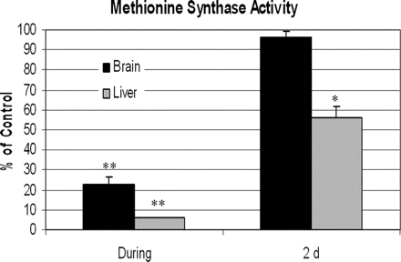
Source: http://www.anesthesia-analgesia.org/content/105/1/83/F4.expansion.html

Slide 20
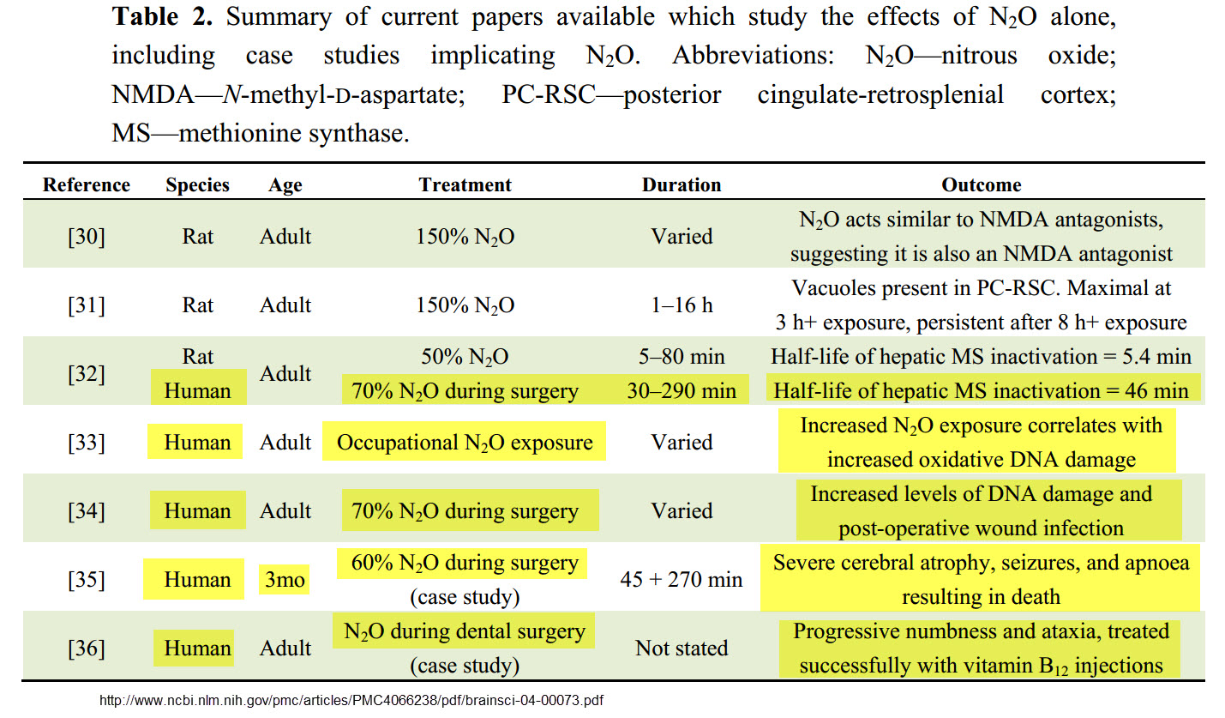

Slide 21
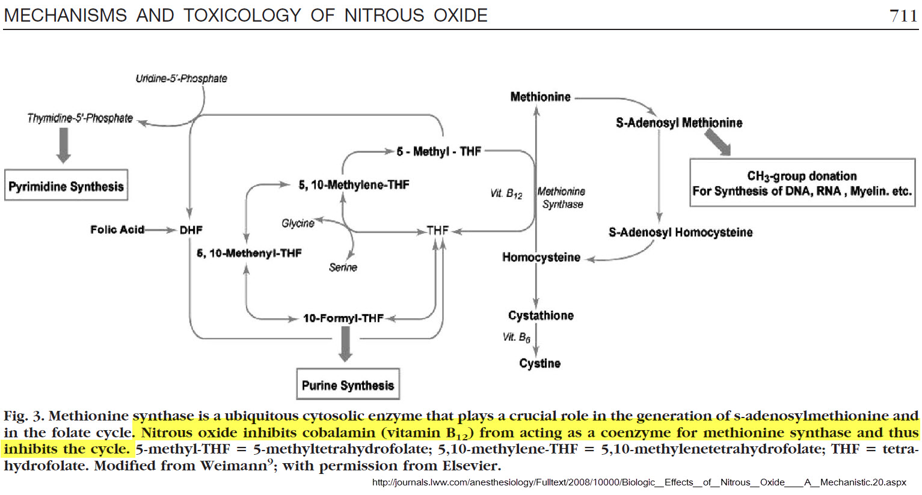
MTHFR

Slide 26
Who’s at Risk?
Screening

Slide 27
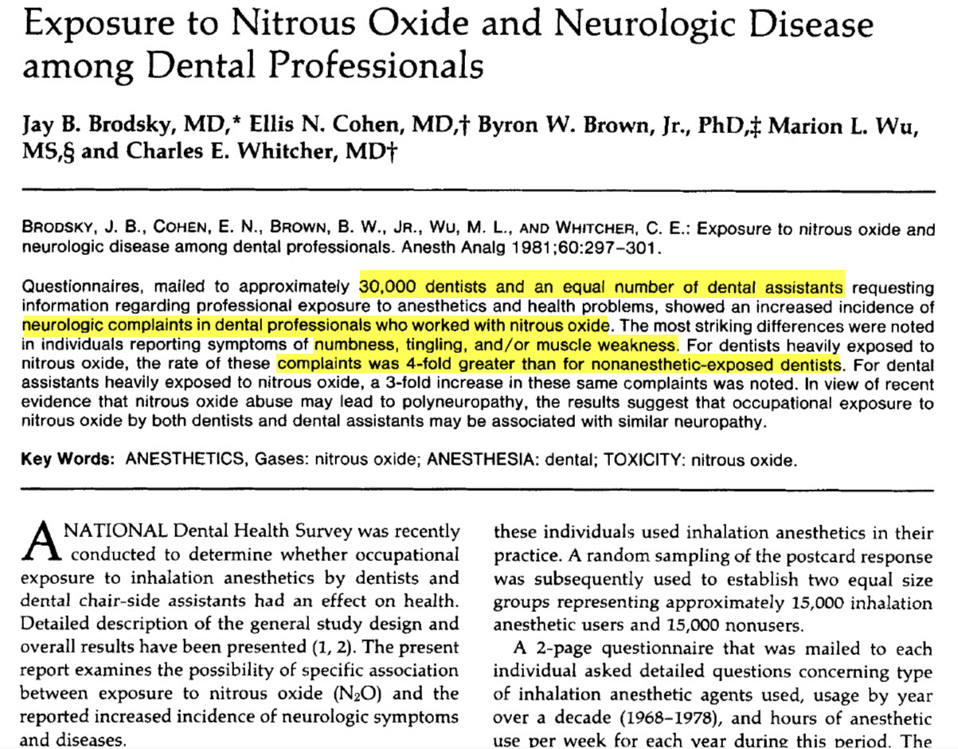

Slide 28
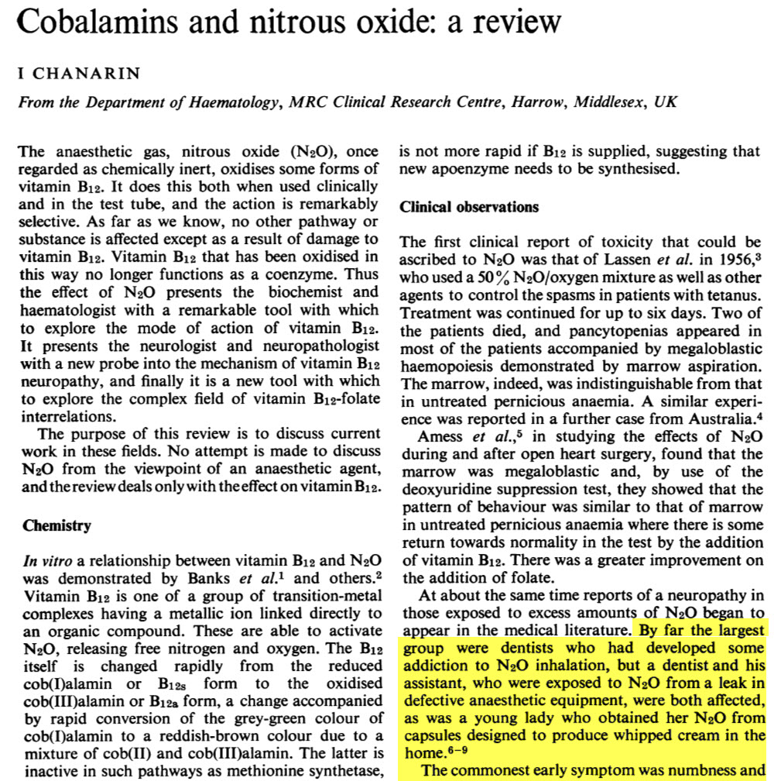

Slide 29
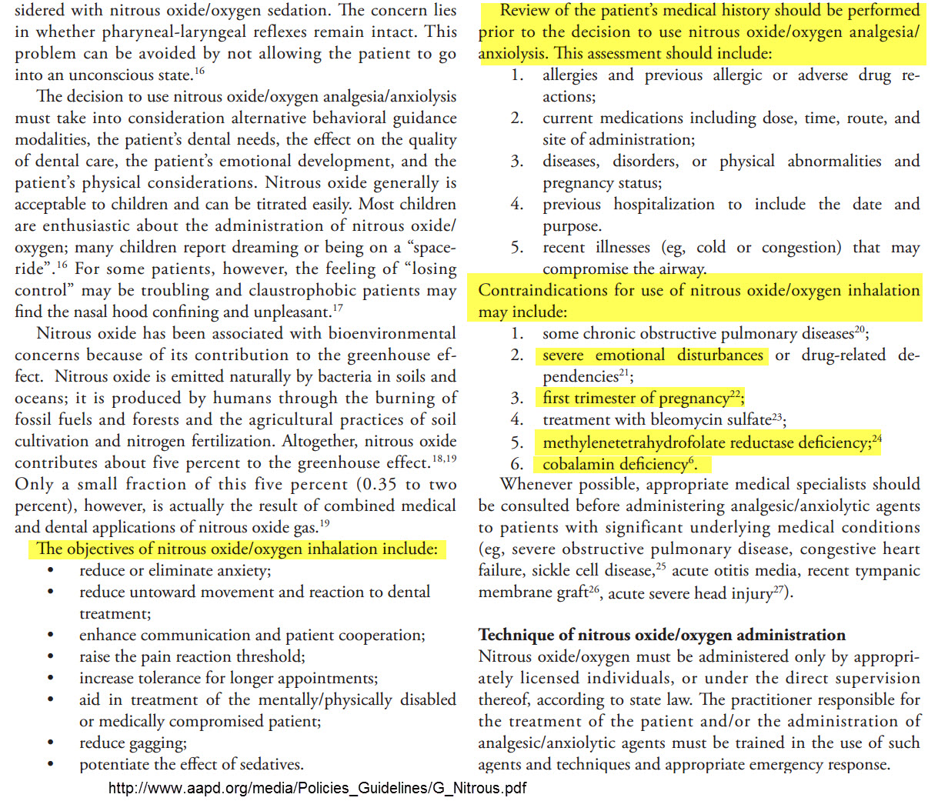

Slide 30
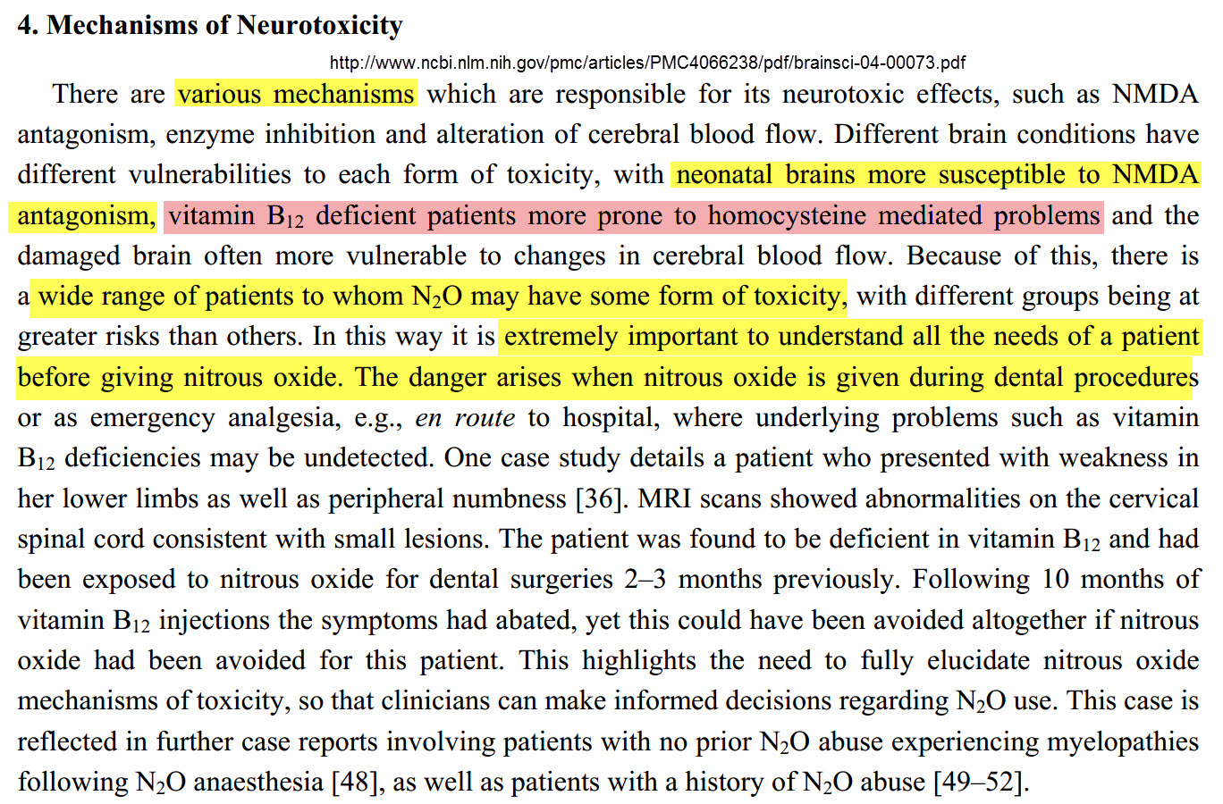

Slide 31
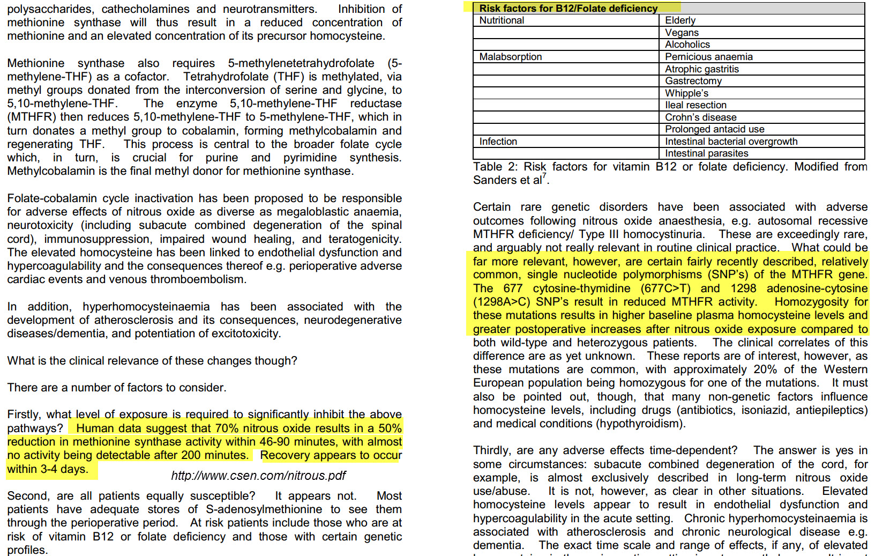

Slide 32
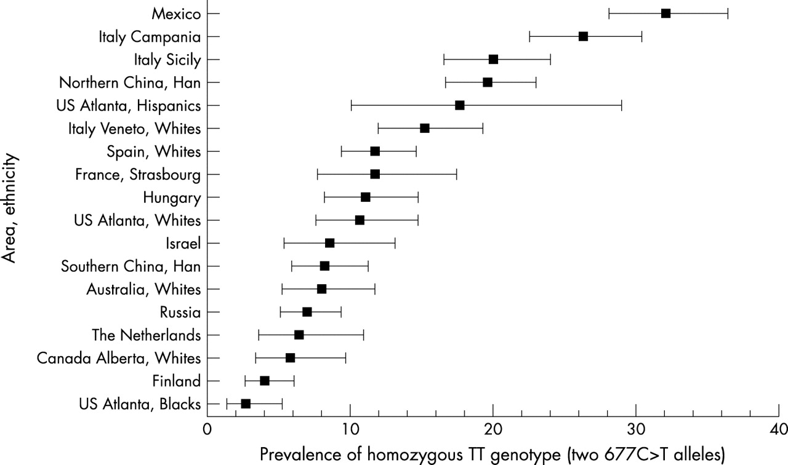
Who are at risk for MTHFR mutations?
Prevalence of homozygous TT genotype (two 677C>T alleles) among newborns by area and ethnic background, ICBDMS 2003
Approximately 45% of the population has 1 copy of the MTHFR C677T
Wilcken B et al. J Med Genet 2003;40:619-625

Slide 33
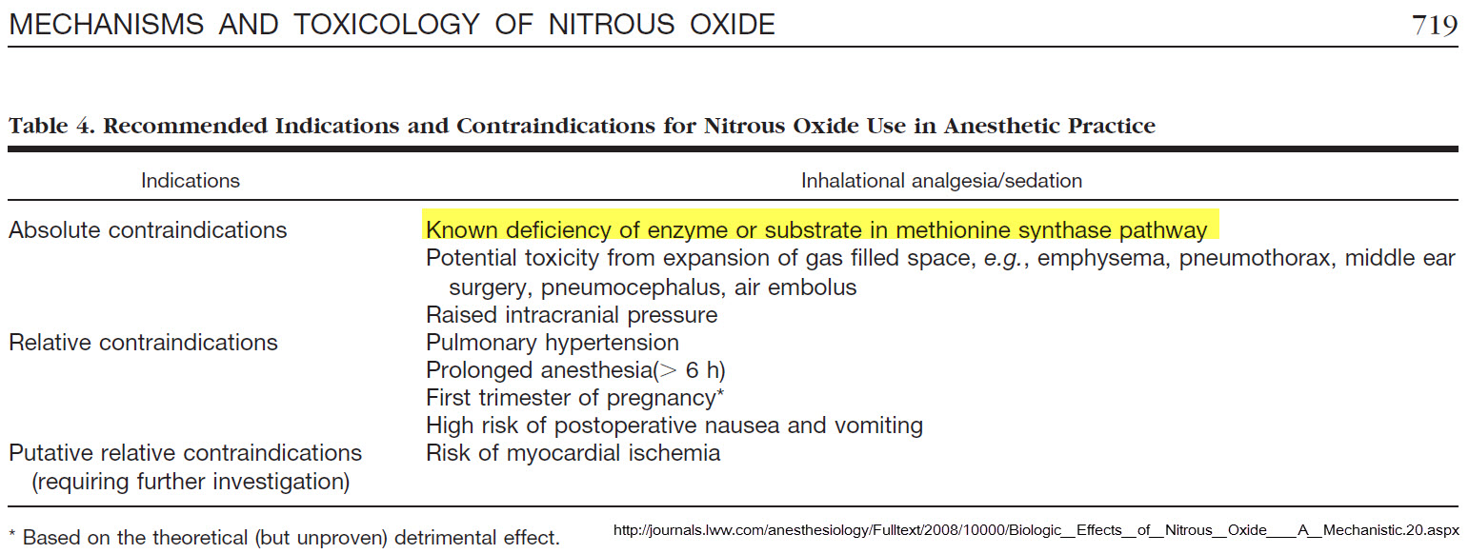

Slide 35
At-Risk Populations for Nitrous Oxide
Oxidative Stress > Glutathione Deficiency and Cell Membrane Damage
Inflammation > TNFa
Pathogens > Candida, viral infxns, h pylori . . .
Heavy Metals
MTHFR
MTR
MTRR
Low or high homocysteine
Methionine deficiency
SAMe deficiency
B12 deficiency
MTHF deficiency
B2 deficiency
B3 deficiency
B6 deficiency
Selenium deficiency
Cysteine deficiency
Glycine deficiency
Glutamate deficiency

Slide 36
“…exposures to chemicals that cause significant depletion of glutathione may ultimately cause a depletion of vitamin B12. In an extreme situation of severely depleted GSH caused by a chemical exposure, typical physiological levels of vitamin B12 may be insufficient to ensure survival of the vitamin…”
H₂0₂ inhibits MTR and promotes CBS
A new role for glutathione: protection of vitamin B12 from depletion by xenobiotics; and How environmental and genetic factors combine to cause autism: A redox/methylation hypothesis

Slide 38
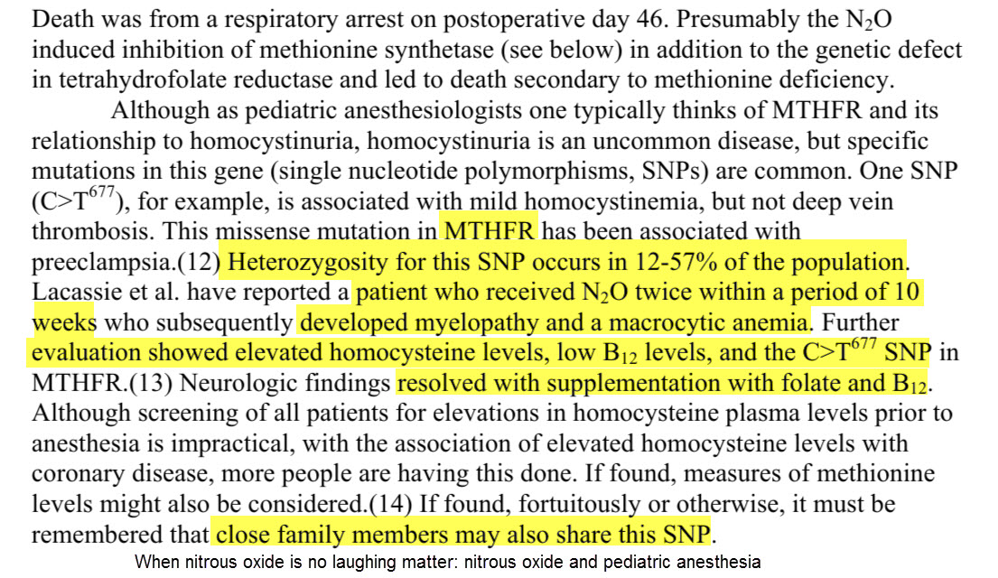

Slide 39
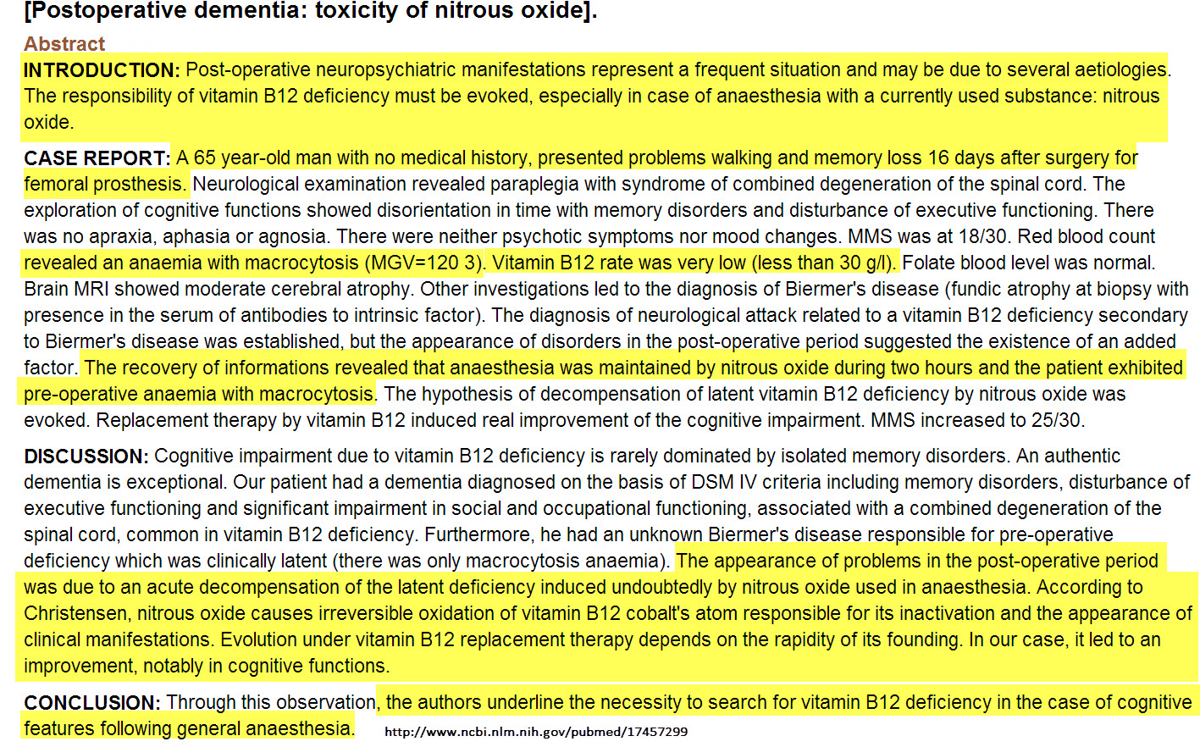

Slide 40
Tylenol/Acetaminophen
Bad?

Slide 41
Key Points to Take to the Clinic
Varying degrees of negative impact
Utilize other interventions to reduce anxiety
Team care
Screen with questionnaire (meds, genes, conditions, age . . .)
Inform patients about the risk of nitrous oxide
Support methylation prior to giving nitrous oxide – and after.

Slide 43
Thank you
Great ways to stay informed:
Newsletter Available at www.MTHFR.net
Facebook: https://www.facebook.com/drbenjaminlynch
October 2013 Nutrigenomics Conference www.SeekingHealth.org
March 2014 Nutrigenomics Conference – www.SeekingHealth.org
Physician’s Forum for Collaboration – www.SeekingHealth.org
Notes:
If our environment and diet are healthy – then the MTHFR SNP is not so significant.

